Slide 1

VFC and beyond – Everything you ever wanted to know!
Karen Turner
Chief, Field Services Section, CA Dept. of Public Health, Immunization Branch
February 12, 2019

Slide 2
Content Overview
VFC Update
VFC Program Background
VFC Eligibility
VFC Enrollment
VFC Vaccines
Vaccine Orders and Distribution (VFC & 317)
Program Integrity
Vaccine Management
Communication, Education & Training

Slide 3
VFC Program Background

Slide 4
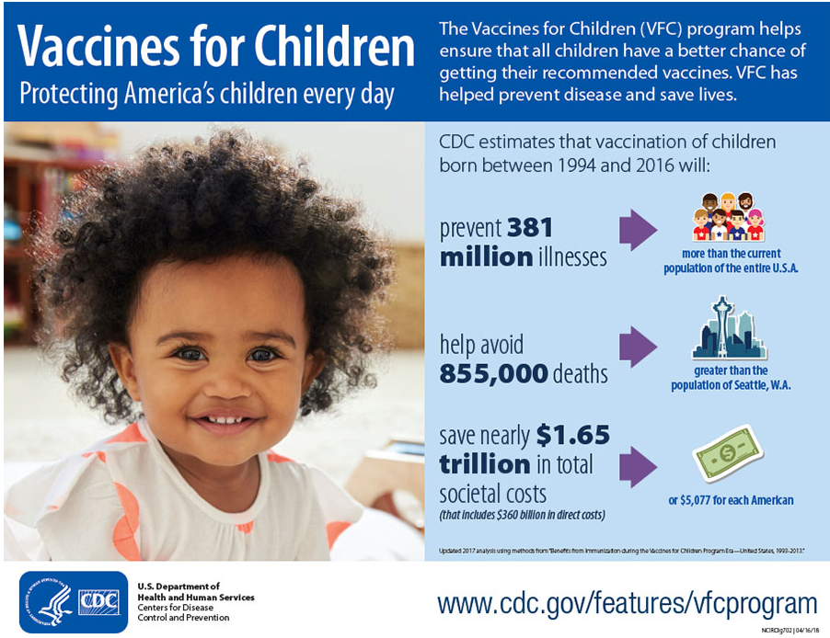
Notes:
Vaccines for Children. Protecting America’s children every day.
The Vaccines for Children (VFC) program helps ensure that all children have a better chance of getting their recommended vaccines. VFC has helped prevent disease and save lives.
Photo of female African-American toddler smiling.
CDC estimates that vaccination of children born between 1994 and 2016 will:
Prevent 381 million illnesses.
Image of arrow pointing to graphic of a group of people with text saying “more than the current population of the entire U.S.A.”
Help avoid 855,000 deaths. Image of arrow pointing to a graphic of the skyline of downtown Seattle with text saying “more than the population of Seattle, Washington.”
Save nearly $1.65 trillion in total societal costs (that includes $360 billion in direct costs). Image of arrow pointing to a graphic of a dollar bill with text saying “or $5,077 for each American.”
Updated 2017 analysis using methods from “Benefits from Immunization during the Vaccines for Children Program Era – United States, 1993-2013.”
CDC/HHS Logo. U.S. Department of Health and Human Services. Centers for Disease Control and Prevention.

Slide 5

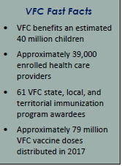

CA VFC Eligible Population
60% of CA children 0-18 years of age (6.3M) are VFC eligible
3,650 Active healthcare providers
  35% Public facilities
  65% Private facilities
Notes:
In CA
Private providers receive VFC funded vaccines to immunize VFC-eligible patients ONLY
LHDs receive a combination of VFC and 317 funded vaccines to immunize VFC eligible children, and uninsured/underinsured adults, and insured persons in limited situations
FQHC and RHC:
receive VFC funded vaccines to immunize VFC-eligible children and “under-insured” children (those with health insurance that does not cover vaccines);
select FQHC enrolled in the VFA program receive 317 funded vaccines for uninsured and underinsured adults.

Slide 6


Vaccine Budgets
VFC
Section 317
2017: $558M
2018: $640M
2017: $8.6M
2018: $8.6M
Discretionary; supports uninsured adult immunization efforts @ LHDs, and VFA sites; outbreak prevention efforts.
Entitlement; supports VFC Program

Slide 7
VFC Program Highlights
The Vaccines for Children (VFC) program is a federally funded program created by the Omnibus Budget Reconciliation Act of 1993 as an entitlement* and a required part of each state's Medicaid plan
The program was officially implemented in October 1994
It provides public-purchased vaccine for eligible children at no charge to VFC-enrolled public and private providers
Covers vaccines recommended by the Advisory Committee on Immunization Practices (ACIP)
  VFC resolutions
Since it’s implementation, VFC has been a great public-private partnership!
*An entitlement is a guarantee of access to benefits based on established rights or by legislation. VFC is an entitlement to the eligible child.
Notes:
An entitlement is a guarantee of access to benefits based on established rights or by legislation

Slide 8
Program Administration
CDC’s National Center for Immunizations and Respiratory Diseases (NCIRD) administers the program nationally
In CA, the Program is administered by the CDPH, Immunization Branch
CA’s VFC Vaccine Budget is ~ $640 M
Notes:
State’s responsibility for the administration of the program include:
provider recruitment & enrollment
administrative accountability procedures
maintaining program integrity
conducting Compliance Site Visits and Unannounced Storage and Handling Visits
program evaluation
integration of VFC activities into existing immunization programs and
The program’s federal budget is almost $4 billion dollars
Federal Program Integrity Initiative seeks to ensure the integrity of operations in all HHS programs, including VFC, to reduce the risk of fraud, waste, and abuse
Funding for the VFC program is approved by the Office of Management and Budget and allocated through the Centers for Medicare & Medicaid Services (CMS) to the Centers for Disease Control and Prevention (CDC)

Slide 9
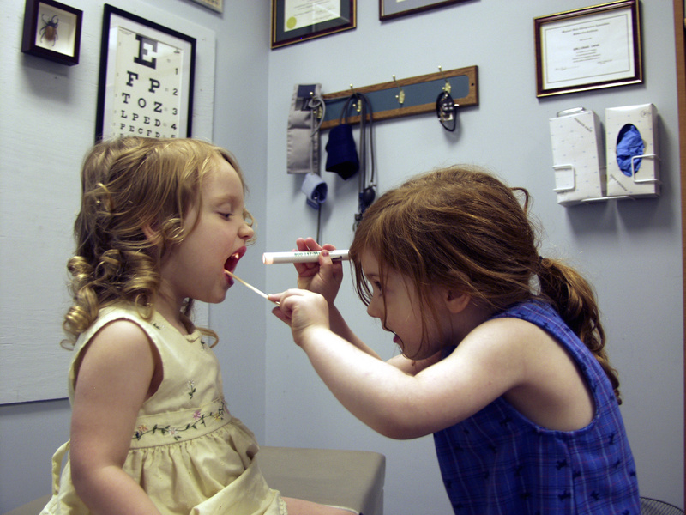
About CA’s VFC Program
60% of CA’s children 0-18 years of age are eligible to receive VFC supplied vaccines (5M)
VFC-Supplied vaccines are provider at no-cost to eligible children 0-18 years of age, including those with no health insurance, American Indian/Alaskan Natives, and Medi-Cal/CHDP eligible children
11 Million doses of vaccines are distributed annually
26,000 calls are received by VFC’s Call center annually, staffed by 7 Customer
Service Representatives
3,600 provider offices enrolled in the VFC Program, most of them are pediatric and family practice offices
½ Billion dollars worth of vaccines are distributed annually
21,000 vaccine orders are processed annually
150 storage and handling incidents are reviewed each month
~1,400 temperature excursions documented through the SHOTS system monthly
Over 2,000 QA visits conducted annually by VFC Field Staff

Slide 10
VFC Eligibility

Slide 11
VFC Eligibility
Children through 18 years of age meeting at least one of the following criteria are eligible to receive VFC vaccine:
  Medi-Cal/CHDP eligible: A child who is eligible for the state’s Medicaid program
    For the purposes of the VFC program, the terms "Medicaid-eligible" and "Medicaid-enrolled" are equivalent
  Uninsured: A child who has no health insurance coverage
  American Indian or Alaska Native: As defined by the Indian Health Care Improvement Act (25 U.S.C. 1603)
  Underinsured: Underinsured children are eligible to receive VFC vaccine only through a Federally Qualified Health Center (FQHC) or Rural Health Clinic (RHC)
    Definition: A child who has commercial (private) health insurance but the coverage does not include vaccines, a child whose insurance covers only selected vaccines (VFC-eligible for non-covered vaccines only), or a child whose insurance caps vaccine coverage at a certain amount. Once that coverage amount is reached, the child is categorized as underinsured.
No other factors can be considered when screening children for eligibility for participation in the VFC program (e.g. residency status or family income)
Eligibility - Parent self reported.

Slide 12
VFC Eligibility: Insured Exceptions
American Indian/Alaska Natives are eligible to participate in the VFC program regardless of insurance coverage.
Insured children with Medi-Cal as a secondary insurance are covered by VFC
    Private vaccines may be administered and billed to the primary insurance or
    VFC vaccines may be administered and Medi-Cal will pay the claim for the administration fee and seek reimbursement from the primary insurance
Incarcerated juveniles under 19 years of age
  an individual who loses access to health benefits under his/her insurance while incarcerated is uninsured for purposes of the VFC program.

Slide 13
VFC Enrollment

Slide 14


Enrollment in VFC
Who can enroll in the VFC program?
  Health care providers authorized to prescribe vaccines under state law providing primary care services to children birth though 18 years of age
Notes:
Requirements
Enrolled providers must agree to follow a set of federal and state requirements to participate in the VFC program
Must have appropriate vaccine storage equipment
Must complete a set of educational modules
All providers must have an initial VFC enrollment visit

Slide 15


Enrollment of Non-Traditional Providers
In order to enroll in CA’s VFC Program:
  Specialty providers, such as OB/GYNs, pharmacies, and others, are required to offer age-appropriate immunizations to patients served by their practice in accordance with schedules determined by the ACIP in its VFC resolutions
PCV, Hib, DTaP, IPV...
MCV, HPV, Tdap...

Slide 16
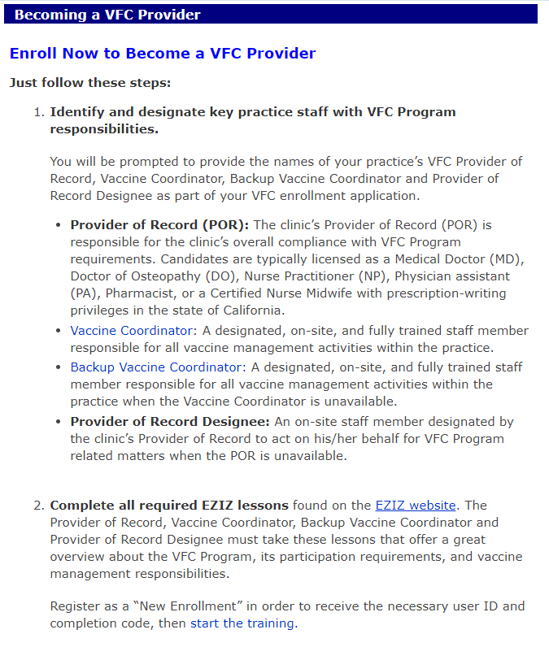
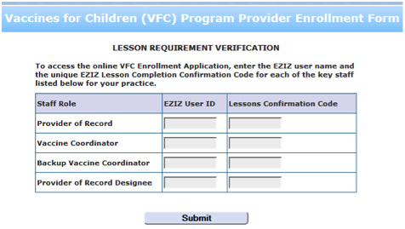
New Enrollments
2019 Enrollment Form now available on EZIZ!
In order for the lesson code to be valid, it must have been taken on or after Dec. 12, 2018
Notes:
This is a screen shot of the new enrollment page now available on EZIZ.

Slide 17
Enrollment in Other State Programs
CHDP
  Participation in VFC is a pre-requisite for enrollment in CHDP
Medi-Cal
  Participation in VFC is necessary for enrollment in Medi-Cal
    Providers are reimbursed for vaccine administration costs only.
    Medi-Cal will not reimburse for the cost of provider-purchased vaccines also available through VFC program
Participation in Medi-Cal or CHDP is NOT a requirement for VFC enrollment.
Notes:
MDs, DO, NP. No RNs

Slide 18
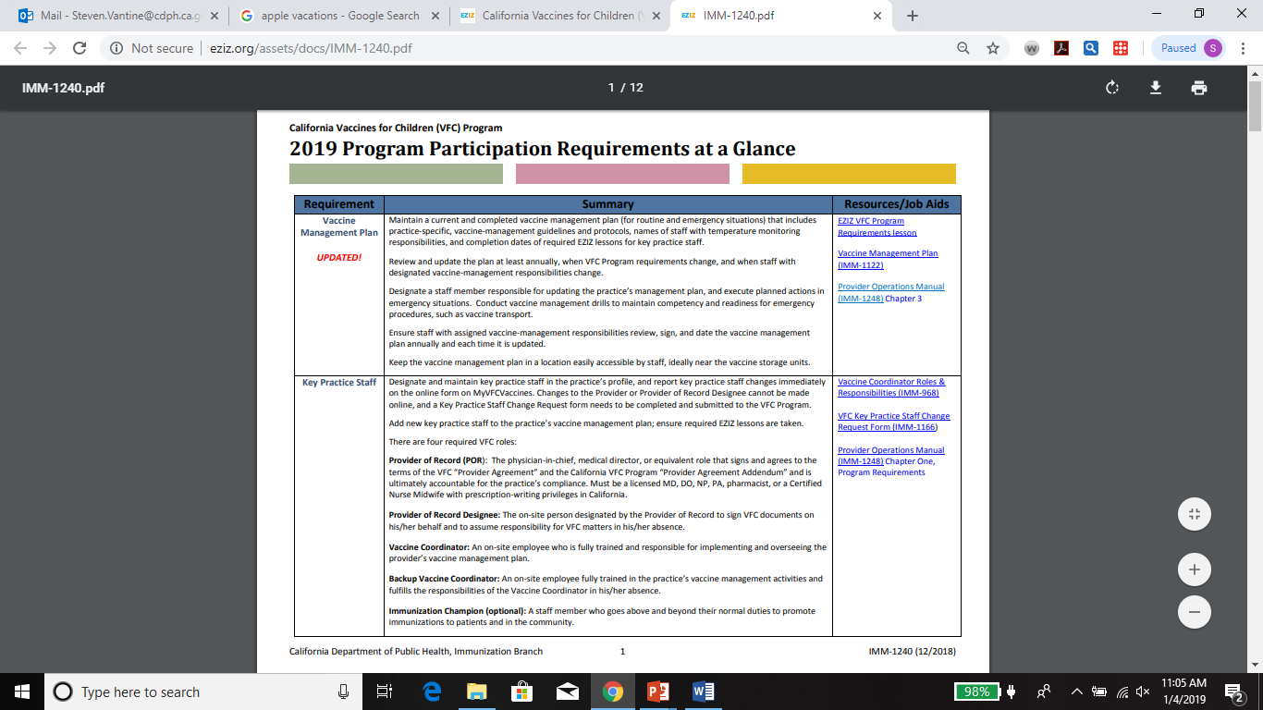
2019 VFC Program Requirements
  VFC participation requirements are summarized in the 2019 VFC Program Participation Requirements at a Glance.
Notes:
We capture all existing requirements and new requirements in our VFC Program participation Requirements At A glance.
This document is available on eziz and it highlights new requirements as well as resources and job aids that help provider implement, comply and train staff on new requirements

Slide 19
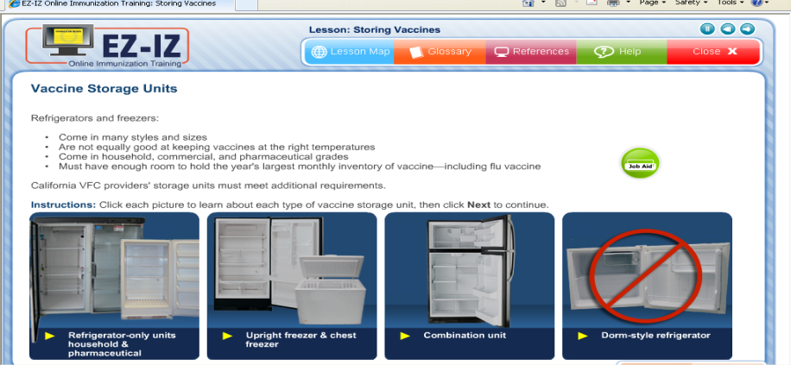
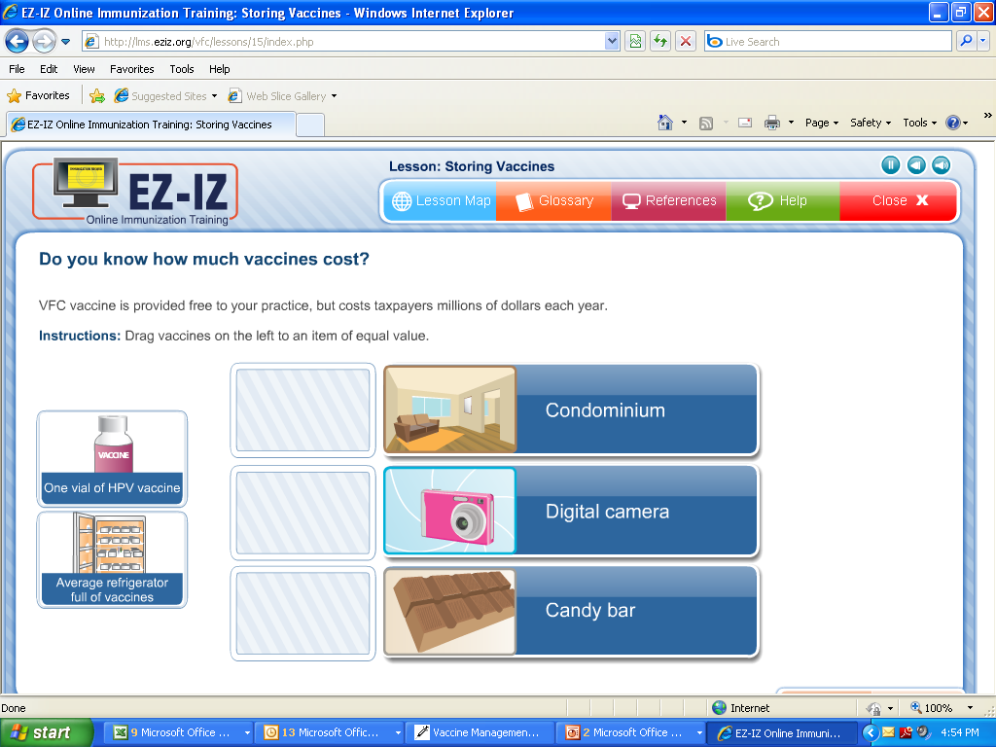
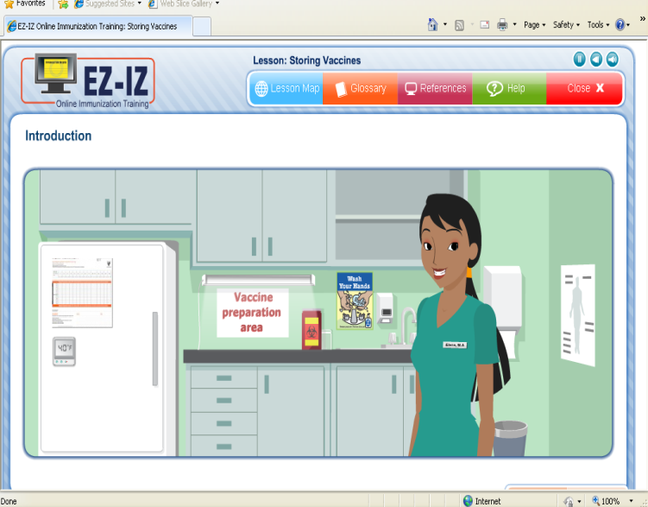
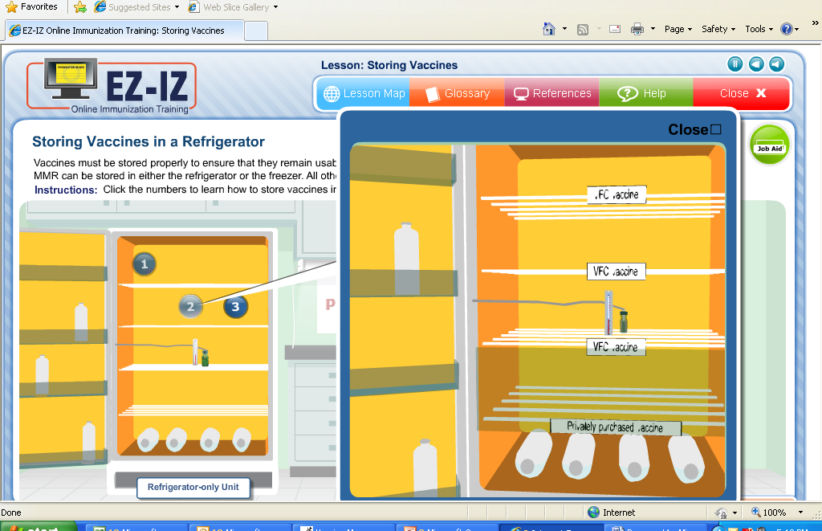
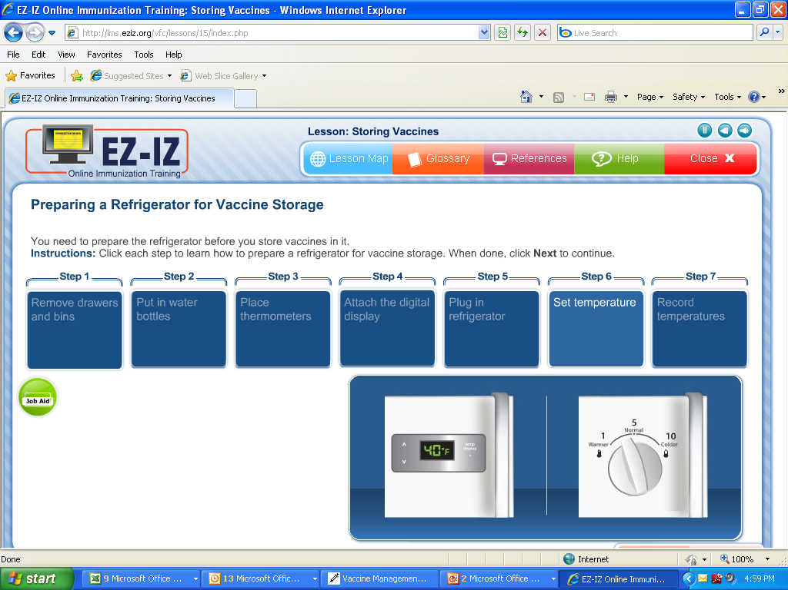
EZIZ Lessons:
Have you completed these lessons?
Notes:
Preparing, Administering, Storing and monitoring temperatures

Slide 20
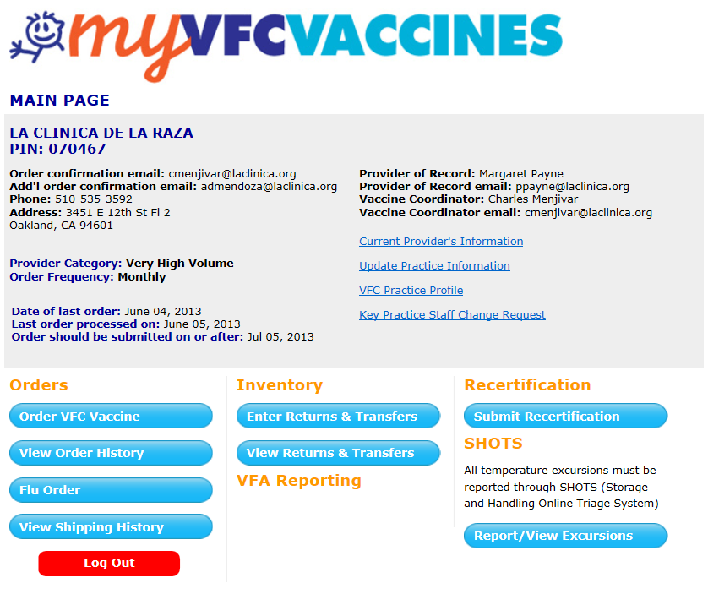
Annual VFC recertification
Typically in December or January
In order to continue participation in the VFC Program, all active providers must submit Recertification through their MyVFCvaccines page
Notes:
Recertification:
· Due date was January 21, 2019
o 3,321 providers have completed 2019 Recertification
o 320 providers are delinquent (see attached list sorted by Region)
· Targeted reminder communication sent to delinquent Recertification providers, January 30
· At that time We let these providers know that their accounts will be suspended on February 1 if they do not complete Recertification.
This will lead to eventual account termination (date TBD).

Slide 21
VFC Vaccines

Slide 22
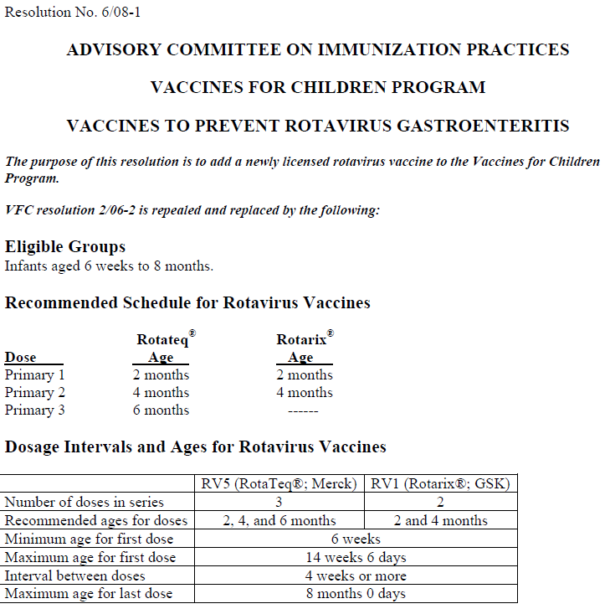
ACIP & VFC Resolutions
The Advisory Committee on Immunization Practices (ACIP) is a federal advisory committee established in 1964 to provide advice and guidance on the most effective means to prevent vaccine preventable diseases
In 1993, Congress gave ACIP statutory authority to determine recommendations for routine administration of vaccines to children and adults in the US
  ACIP develops technical recommendations on vaccine use and administration
  Approves vaccines to be provided through VFC
  Recommends immunization schedules that are harmonized with recommendations from other advisory groups such as AAP and AAFP
After ACIP approves a specific vaccine to be included in VFC, in the form of a written VFC resolution, a vote is taken by the ACIP’s members to officially include the vaccine in the Program
  VFC resolutions passed by the ACIP form the basis for VFC Program policies on vaccine availability and usage

Slide 23
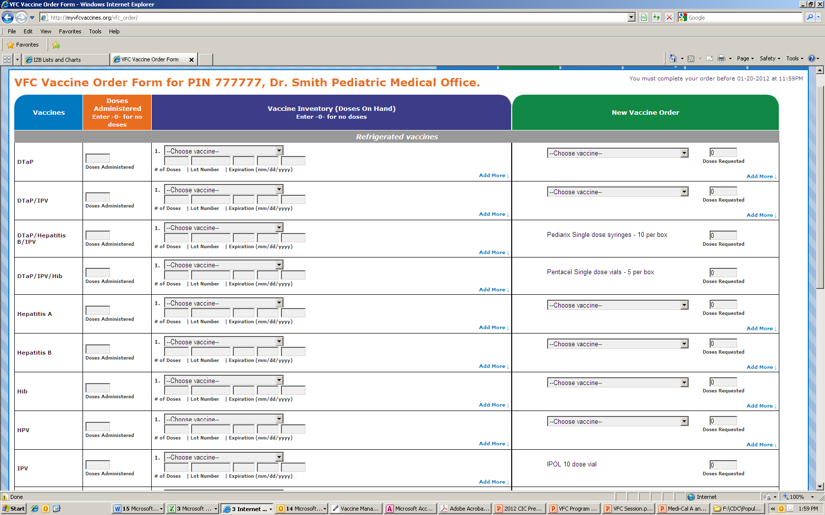
Vaccines Available Through VFC
The VFC Program includes all ACIP-recommended vaccines
New vaccines are quickly incorporated into the program
  After the negotiation of a federal vaccine price contract
  An official vote from ACIP and
  A VFC Resolution
CA makes all product, brands and presentations available to enrolled providers.

Slide 24
VFC Program Requirement: Vaccine Availability
VFC entitles children to all ACIP vaccines
VFC Providers agree to comply with immunization schedules, dosages, and contraindications that are established by the Advisory Committee on Immunization Practices (ACIP) for the vaccines identified and agreed upon in the Provider Agreement and Provider Profile UNLESS:
In the VFC Provider's medical judgment, and in accordance with accepted medical practice, the VFC Provider deems such compliance to be medically inappropriate for the child;

Slide 25
Billing, Reimbursements and Administration Fees
The federal Vaccines For Children (VFC) program supplies vaccines to enrolled physicians at no cost.
  Providers CANNOT bill or charge for the cost of VFC-supplied vaccines.
Providers may bill for the administrative cost of administering a dose of vaccine, AKA the “Vaccine Administration Fee”
  The administration fee is per vaccine and not per antigen within the vaccine (combination vaccines).
  Vaccine administration fees not to exceed a regionally set fee cap of $26.03 per dose may be charged to non-Medicaid eligible patients
  For Medicaid VFC-eligible children, the reimbursement for immunization administration fees (set by the state Medicaid agency) must be billed to the Medicaid program and NOT the patient.
Billing or reimbursement processes are between the enrolled provider and the patient or the enrolled provider and the state’s Medicaid Agency.

Slide 26
Vaccine OrderS & Distribution
VFC and 317

Slide 27
Vaccine Ordering
VFC Vaccines
  Providers select preferred product and packaging from a number of products and brands available on the VFC order form
  Limit to selecting one brand to prevent administration errors
Vaccine ordering is a provider responsibility
  Providers must order responsibly
  According to VFC-eligible populations in their practice
  May NOT allow an external organization to order vaccines on their behalf
  Assume financial responsibility for doses wasted
Under NO circumstance may use VFC vaccines in non-VFC populations
  Borrowing (from VFC or private stock is not allowed)

Slide 28

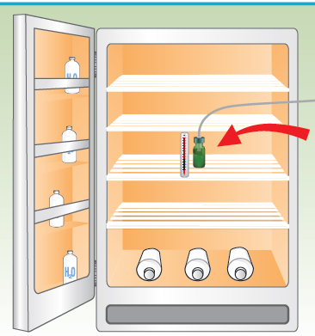
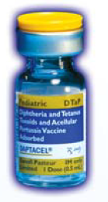



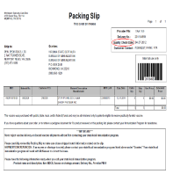

State Immunization Program
McKesson
Order is placed for each PIN
VFC Office.
Provider
‘em
Pack
We
Reviews, approves, and submits vaccine order to CDC & distributor
Submits a vaccine request
Eligibility screening must occur prior to administering vaccines

Slide 29
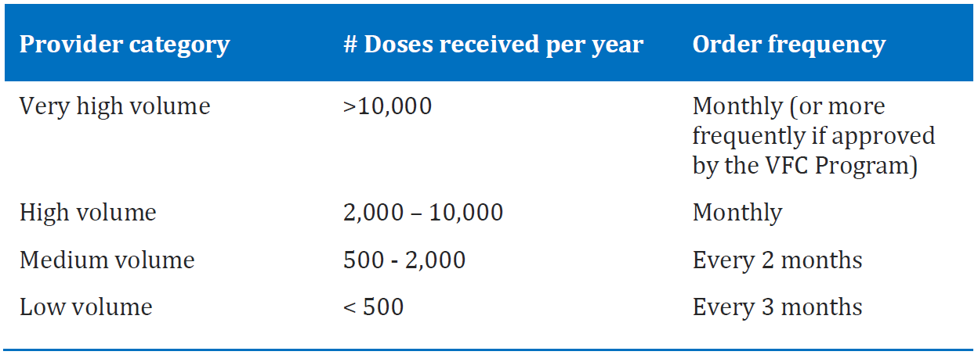
Order Frequency
Order frequency depends on the provider category and number of VFC-supplied doses ordered each year. Provider category is assessed annually as part of provider recertification, and order frequency is adjusted accordingly and displayed on the provider’s account page at MyVFCvaccines.org.
Notes:
If you think you are going to need more vaccine than usual for peak vaccine times (back to school or Flu) you need to make a comment in your order. If you are consistently running out of vaccine you may need to update your patient profile.

Slide 30
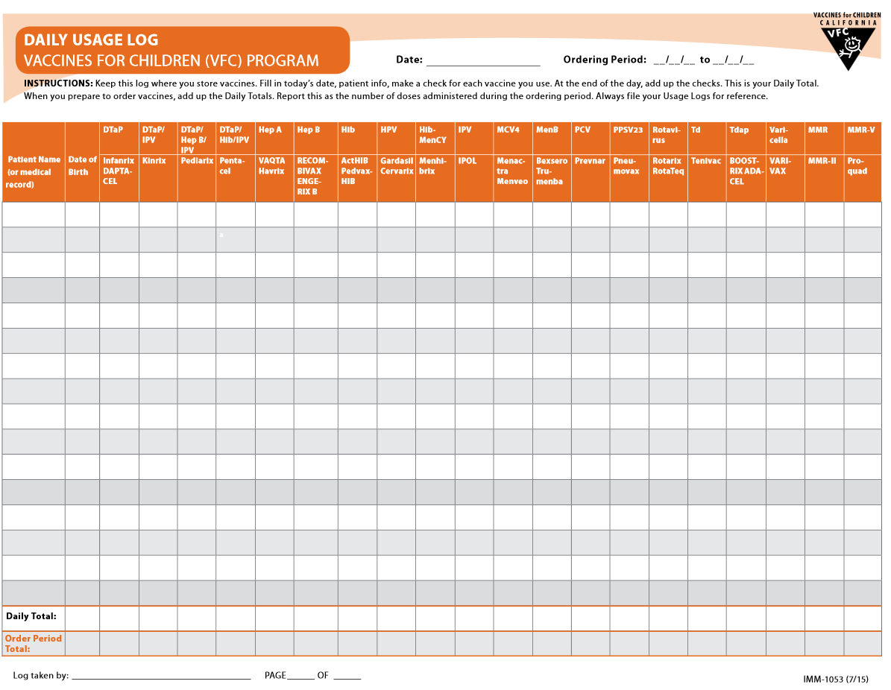
Vaccine Ordering AND Accountability
With every vaccine order, providers must account for all VFC doses received during the preceding ordering period.

Slide 31
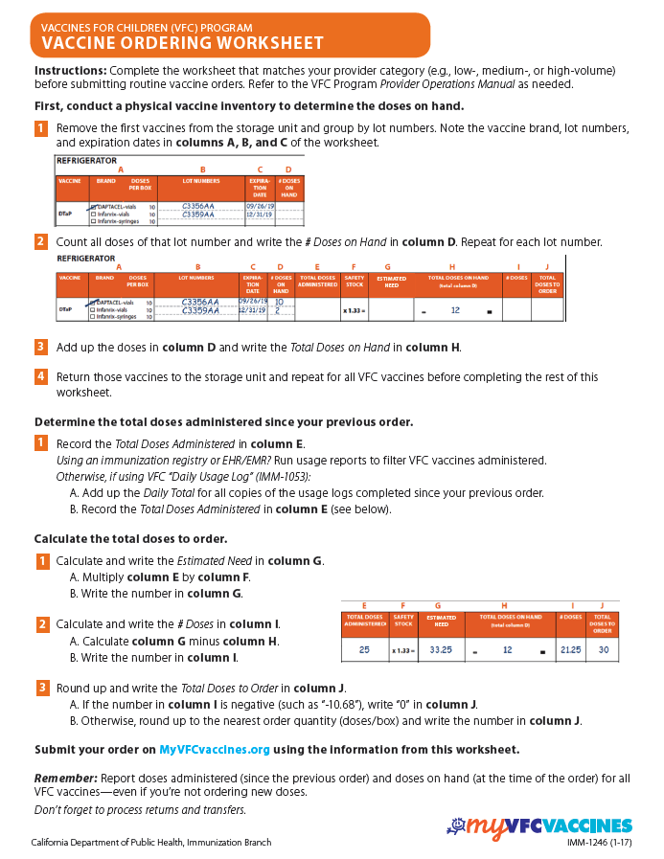
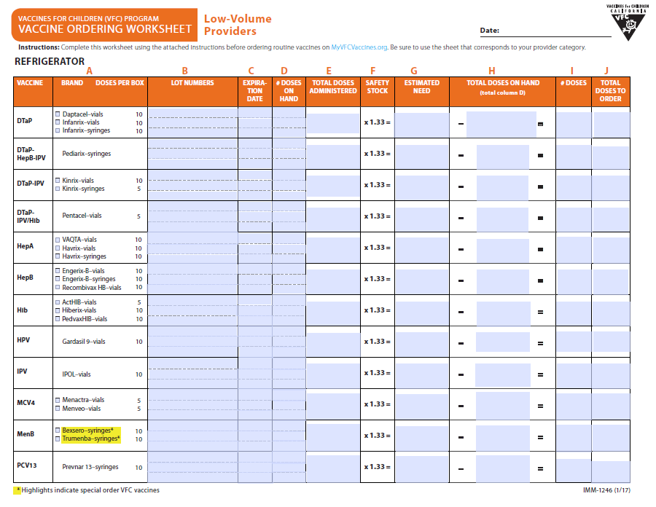
Vaccine Ordering Worksheet

Slide 32
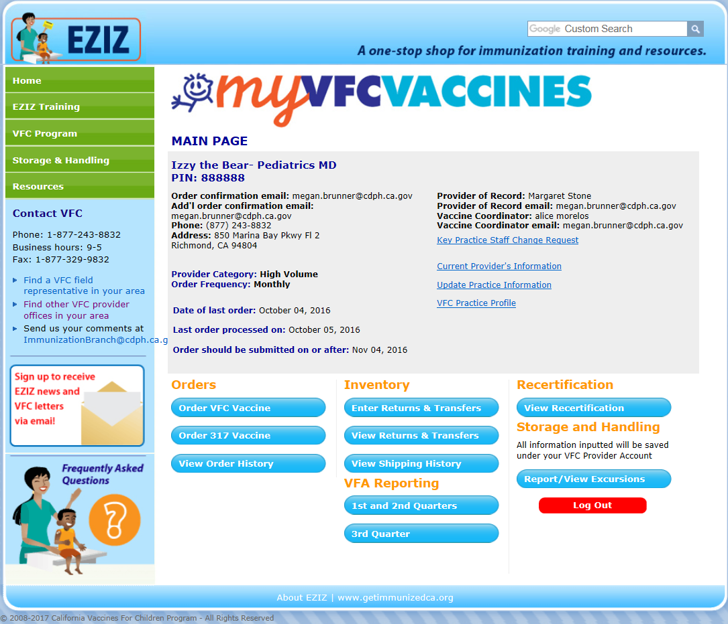
On-Line Ordering
http://eziz.org/myvfcvaccines/

Slide 33
VFC Order Form: Private Providers
Notes:
IN reality …. the “Vaccine Order Form” is a multi-purpose form
Vaccine Delivery- Top Section
Ensure vaccines arrive at the correct location and at specified delivery times
Vaccine Accountability-Columns 1-4
Ensure VFC vaccines are appropriately accounted for
Monitor vaccine expiration dates
Verify the appropriateness of a vaccine order
New Vaccine Requests- 5-6
Each of the four sections of the VFC order form must be completed fully and accurately
It is the responsibility of clinic’s staff to complete and submit VFC vaccine requests

Slide 34
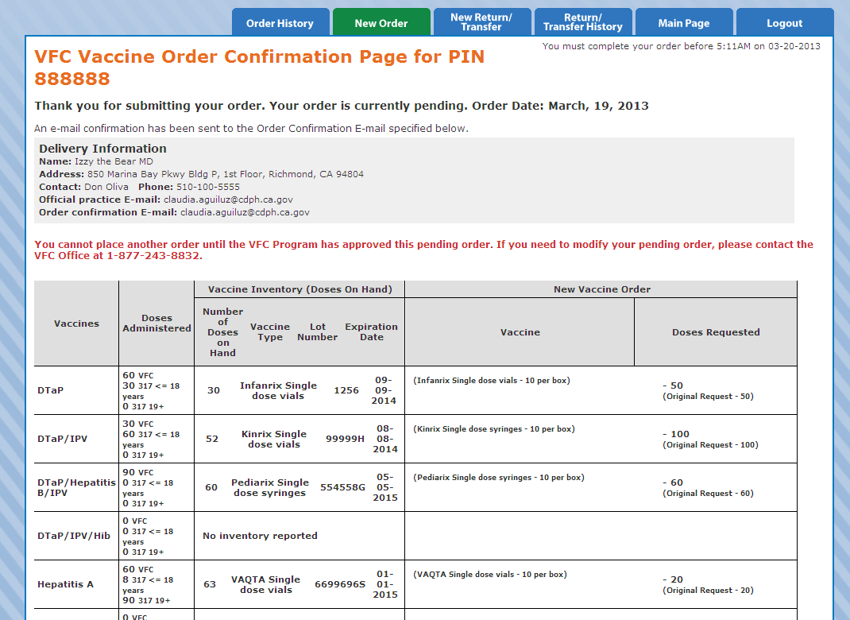
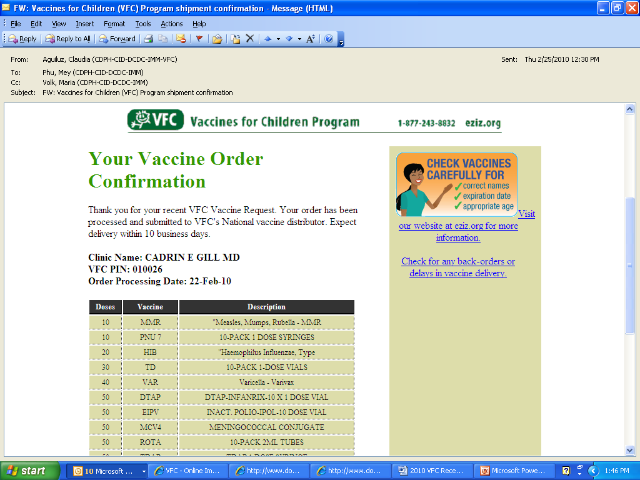
Order Confirmation

Slide 35
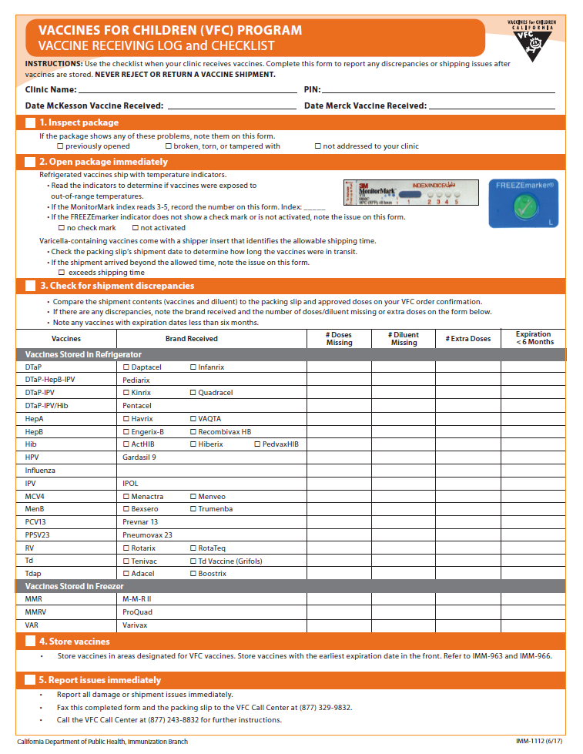
Receiving Vaccine Shipments
Providers are asked to carefully inspect the contents of the shipments upon receipt
  Cold chain integrity: verify temperatures have been maintained while vaccine was in transit
  Contents: verify vaccine doses received match doses outlined in the packing slip.
VFC must report all shipment incidents to VFC’s national vaccine distributor within 2 hours of vaccine delivery in order to ensure vaccine replacement costs (if due to a distributor or shipping error) is covered they the distributor, not the VFC program.
Vaccine shipments should NEVER be rejected without prior approval of the VFC Program.

Slide 36
Program Integrity

Slide 37
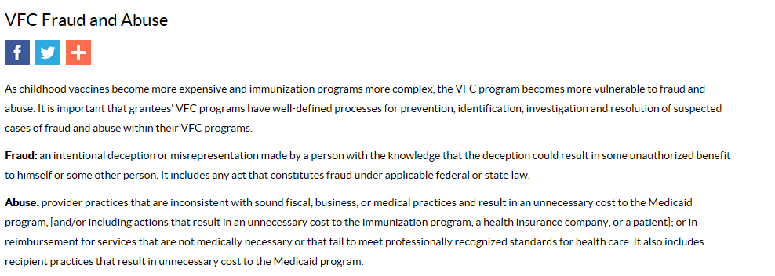
Program Integrity (Fraud and Abuse)

Slide 38
Vaccine Restitution Policy
Vaccine Loss Due to Provider Negligence
Every provider signs an annual agreement that describes the provider’s financial liability to replace vaccine purchased with federal funds (VFC, 317) that are deemed non-viable due to provider negligence on a dose-for-dose basis
Providers must replace the same number and type of vaccines that were lost—on a dose-for-dose basis. Providers must submit a receipt of vaccine purchase (reflecting a dose-for-dose replacement) to the VFC Program within 90 days of vaccine loss, or within an acceptable timeline as negotiated with the VFC Program.
In general, restitution requires the following actions:
  Providers must sign a VFC Program vaccine restitution agreement.
  Providers must provide copies of vaccine invoices for privately purchased vaccines to replace doses lost.
  Providers must submit a detailed listing of vaccines for all VFC patients who received privately purchased vaccines.
  The VFC Program might suspend provider vaccine ordering privileges.

Slide 39
Vaccine Restitution
Dose by Dose replacement
Providers must agree to replace vaccine on a dose-for-dose basis that is purchased with federal funds and deemed non-viable due to provider negligence or misuse.
Once a provider meets the Program’s criterion for restitution, lost doses must be replaced with doses purchased at private pricing
Vaccine | Brandname/ Tradename | NDC | Packaging | CDC Cost/ Dose | Private Sector Cost/ Dose
Measles, Mumps and Rubella (MMR) [1] | M-M-R®II | 00006-4681-00 | 10 pack – 1 dose vial | $21.05 | $70.92
MMR/Varicella [2] | ProQuad® | 00006-4171-00 | 10 pack – 1 dose vial | $125.11 | $202.41

Slide 40
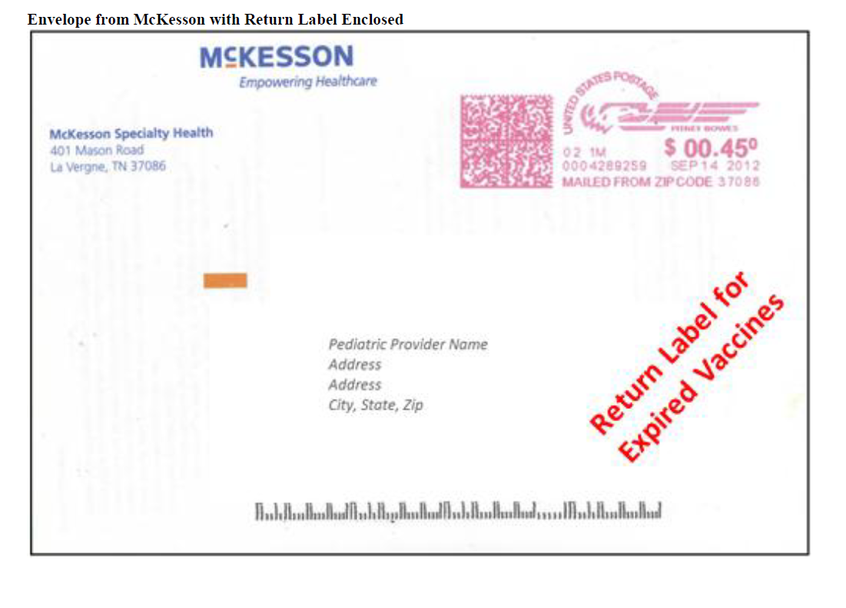
Vaccine Returns
All unused & un-opened spoiled/expired vaccines must be returned to McKesson to recoup Federal Excise Tax
Procedure for returning vaccines
  Complete and submit a Return form online by logging into your MyVFCvaccines account
  Identify the vaccine funding source
  Shipping labels can be requested by indicating the number of labels needed and selecting type
    Electronic label sent by email
    Label is valid for 30 days
    To be used with vaccines in the return forms
  Ship vaccines back as soon as possible (within 6 months of spoilage/expiration)
Electronic Return Labels are directly generated by UPS. Provider will receive email from UPS Quantum View with the subject line of UPS Label Delivery.

Slide 41
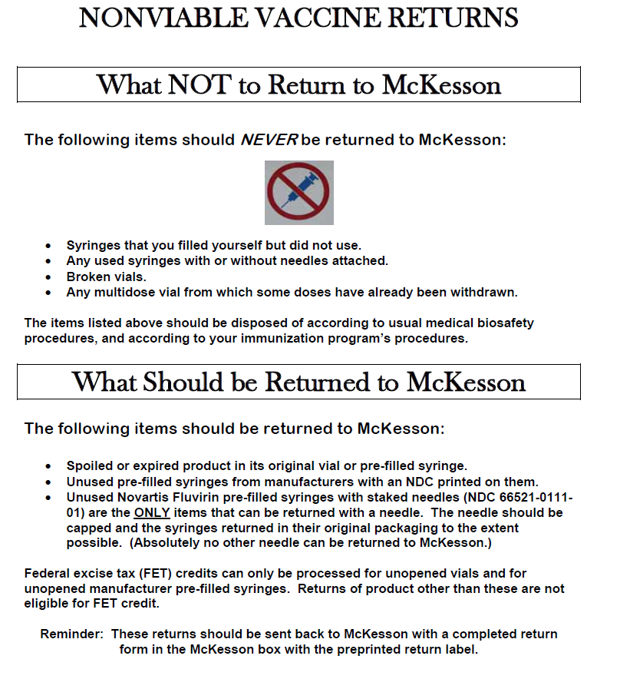

Slide 42
Vaccine Management
Storage and Handling

Slide 43
Our Goal
Ensure providers improve the quality of they vaccine management from receipt to administration, including:
  Storing vaccines appropriately and in the right units
  Monitoring temperatures, and using the correct units
  Managing and monitoring inventory
  Accounting for vaccines received
  Preventing vaccine loss and wastage

Slide 44
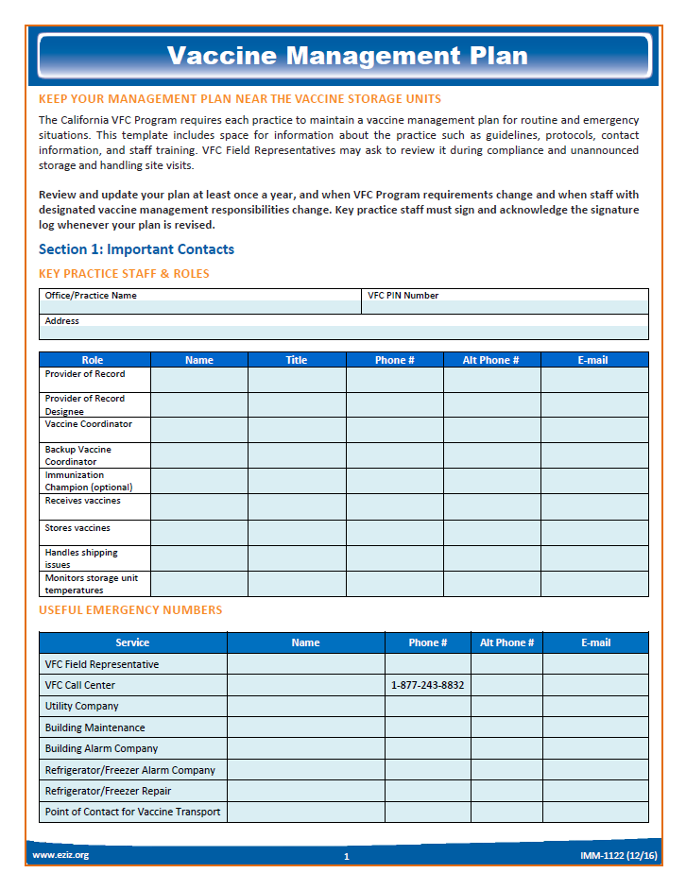
Written Vaccine Management Plans
All facilities storing and administering vaccines should have a Vaccine Management Plan
  Required for participation in the VFC Program
VFC’s template Vaccine Management Plan has 2 components:
  Routine – include all aspects of vaccine management, from ordering, storage conditions to temperature monitoring.
  Emergency – Outline steps and key contacts in case of an emergency, such as a planed or unplanned power loss.

Slide 45
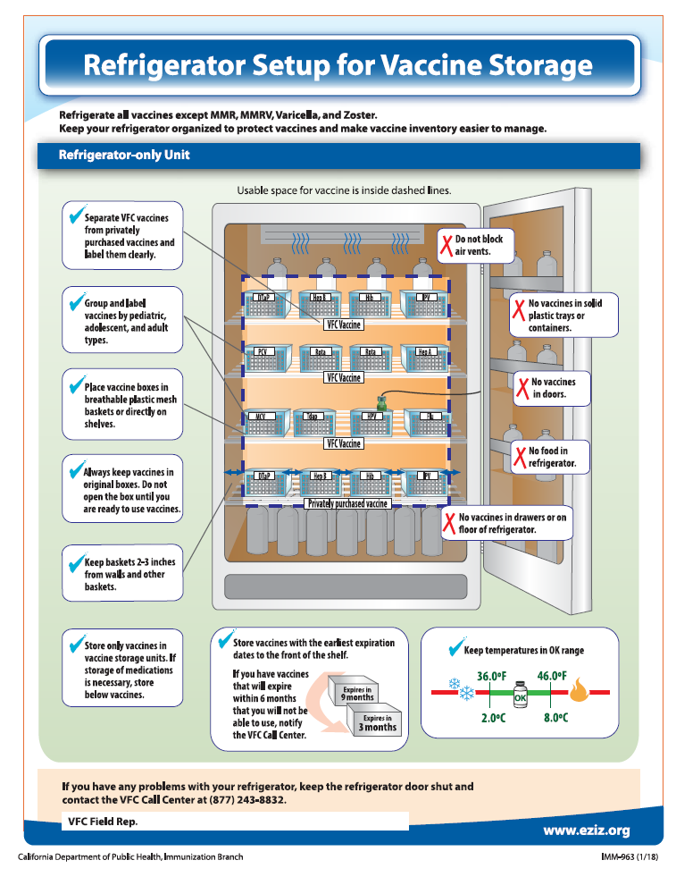
Storage and Handling
Storage and handling is a large part of all VFC site visits. Reviewers ask questions from the CDC PEAR reviewer guide. Provider responses are validated by looking either at vaccine storage units, temperature monitoring equipment or the vaccine inventory inside a unit.

Slide 46
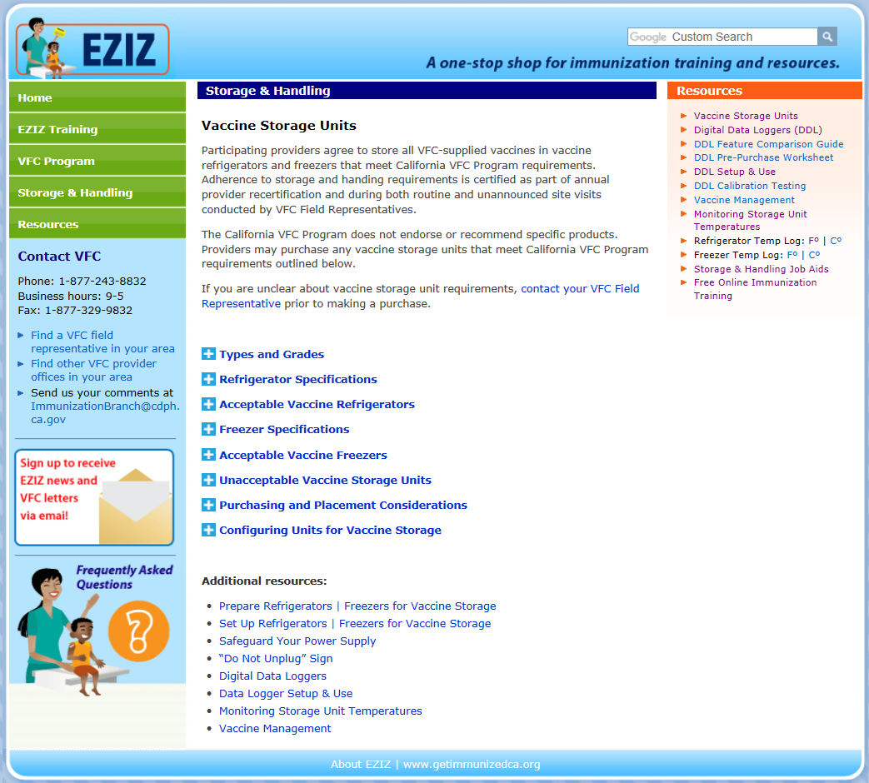
Appropriate Vaccine Storage Units
Vaccine storage units must be reliable, maintaining adequate temperatures at all times to protect vaccine supply.
  Go to http://eziz.org/vaccine-storage/ for more specific information on vaccine storage requirements.

Slide 47
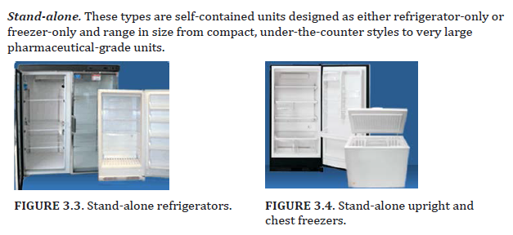
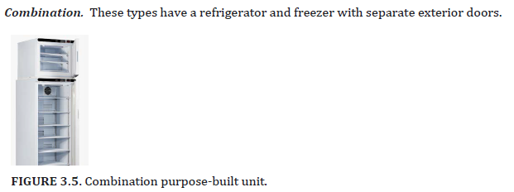
Key Terms
Purpose-built. These grades are specifically designed to maintain consistent temperatures for storage of vaccines or biologics. They might be designed for pharmacy, biologic, or laboratory environments.
Commercial. These grades are intended to store food and beverages in commercial settings. They are often larger and more powerful than household units but are not designed to store biologics. They experience some temperature fluctuations.
Household. These grades are intended for food storage—typically in homes and offices.

Slide 48
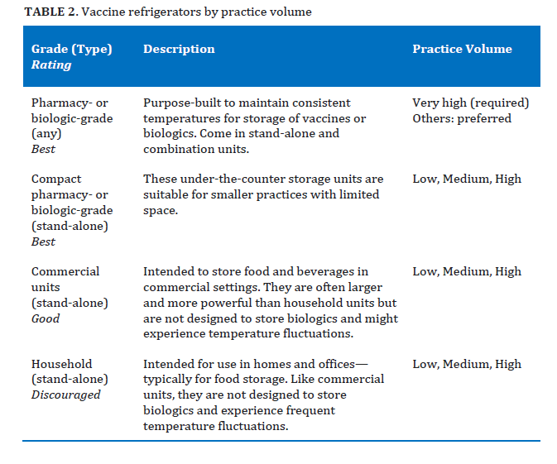
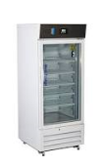

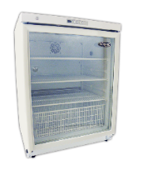
Acceptable Vaccine Refrigerators

Slide 49
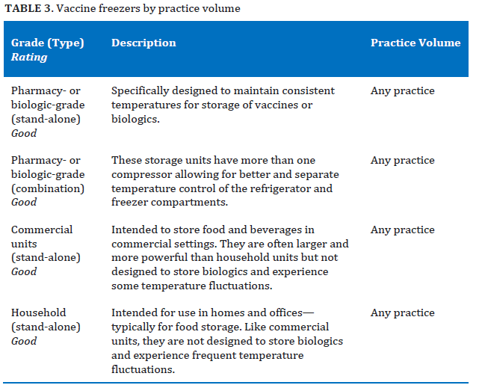
Acceptable Vaccine Freezers

Slide 50

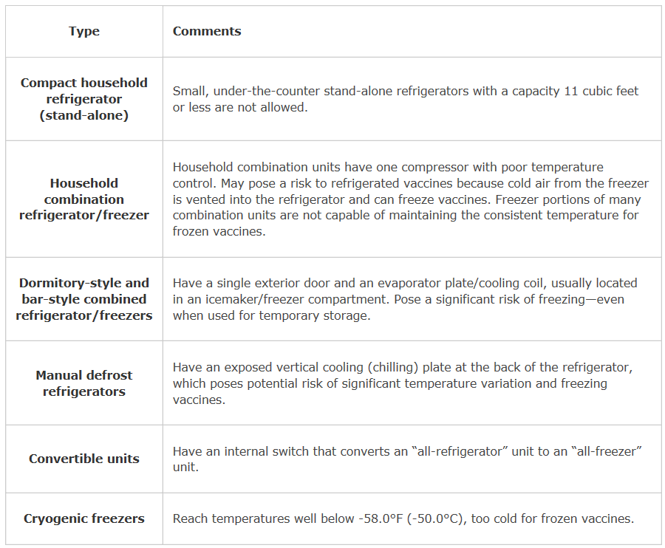
Unacceptable Units
These do not meet VFC specifications and may not be used to store vaccines.

Slide 51
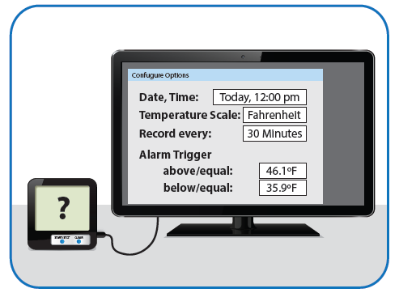
Temperature Monitoring: Required use of Digital Data Loggers
Requirement: Required use of Digital Data Loggers to monitor temperatures of any unit storing VFC supplied vaccines
Notes:
We introduced several new requirements during 2018, and the first one is related to temperature monitoring.
All vaccines supplied by the VFC program must have temperatures monitoring using a continuous temperature monitoring devices, such as Digital data loggers.
This includes primary refrigerators and freezers, back-up fridge and freezers, and during any vaccine transport.
Also, any back-up thermometers must now be a digital data logger.
The majority of VFC sites recertified had to confirm they are now utilizing these devices.

Slide 52
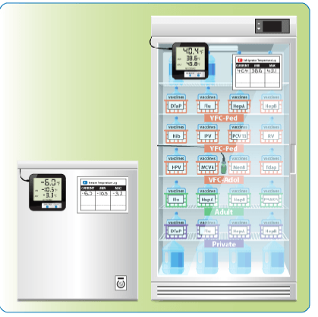
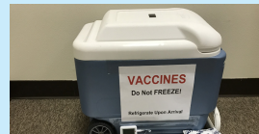
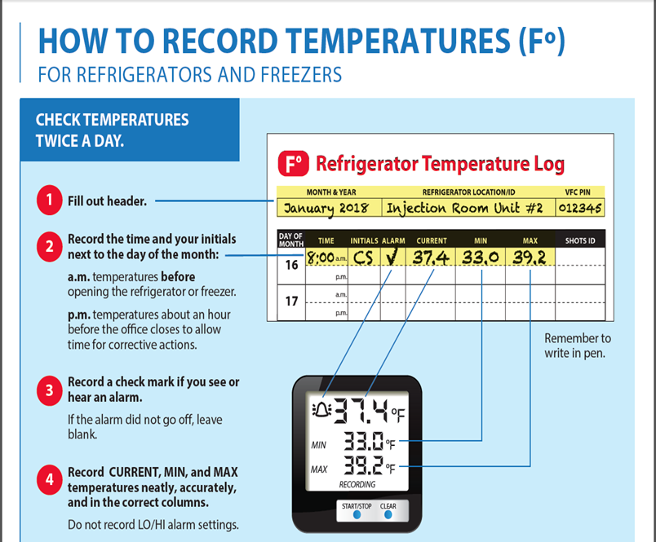
DDLs and temperature monitoring
use digital data loggers or similar continuous temperature monitoring devices to monitor temperatures in any unit (refrigerator, freezer, or transport cooler) storing VFC supplied vaccines.
Data loggers must comply with VFC temperature monitoring device requirements.
At least one VFC-compliant back-up digital data logger device must be readily available on site for use during any instance of vaccine transport or when primary devices fail, or being calibrated.
Store the backup device’s buffered probe in the vaccine storage unit; store the digital display in a cabinet and document its location on the practice’s vaccine management plan.
All key practice staff monitoring storage unit temperatures must be trained;
  how to operate the practice’s data loggers
  interpret on-screen temperature readings
  download temperature reports
  properly configure HI and LO temperature alarm limits
Main Fridge
Day Use
Vaccine Transport
Notes:
Transitioning to this new devices was really the first step, and we are strongly emphasizing that All key practice staff monitoring storage unit temperatures must be trained;
how to operate the practice’s data loggers
interpret on-screen temperature readings
download temperature reports
properly configure HI and LO temperature alarm limits

Slide 53
Data Logger Requirements
Feature | Description
Accuracy | +/-1.0°F (+/-0.5°C)
Logging interval | Programmable (at least every 30 minutes)
Memory storage | 4000 readings or more
Buffered temperature probe | Only use the buffered probe bundled with the device Detachable from unit, or permanently embedded in a buffer as long as the temperature monitoring system can be calibrated Immersed in a vial filled with thermal buffer material, including liquid up to 60 mL (e.g., glycol, ethanol, or glycerin), loose media (e.g., sand or glass beads), or a solid block of material (e.g., Teflon® or aluminum)
Digital display | Active external display Must include current, MIN, and MAX temperatures Must be in close proximity to the vaccine storage units and temperature logs Low-battery indicator
Alarm capabilities | Programmable Visual or audible alarm to signal out-of-range temperatures

Slide 54
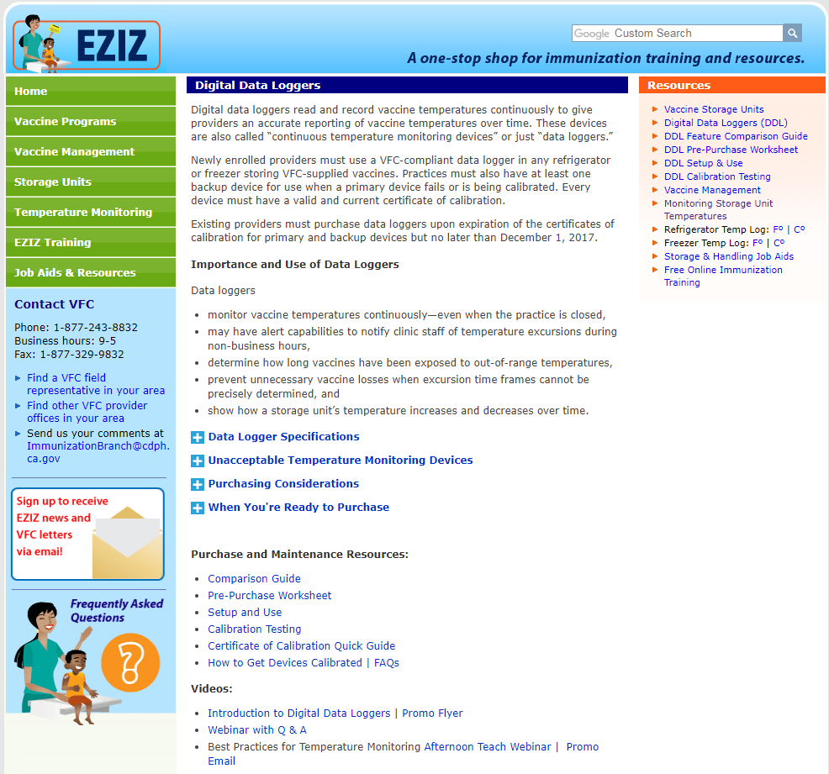

Data Logger Resources
http://eziz.org/vaccine-storage/digital-data-loggers/

Slide 55

Training and Supervision
Temperature monitoring is not a purely mechanical exercise.
Understanding the impact of the activity is critical.
Responsible staff must know how to react effectively to problems as soon as they arise.
Training not only is essential to allow adequate time for initial training, but training should be on-going, and verified.

Slide 56
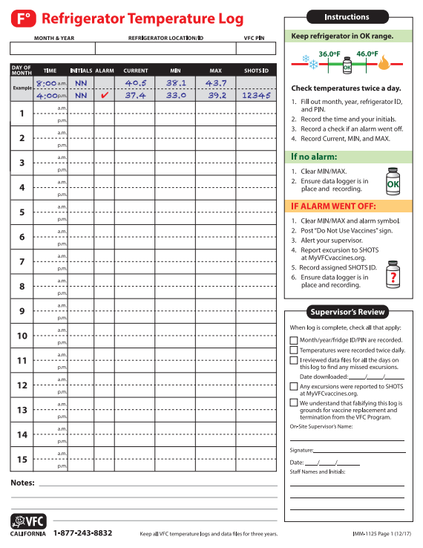
Temperature Monitoring and Documentation
Read and document CURRENT, MIN & MAX temperatures twice daily
Document names and initials of staff members with temperature monitoring responsibilities
Supervisory review of completed logs
Check if thermometer alarms have been triggered
Online documentation of actions taken when temperature excursions are identified (record SHOTS ID)

Slide 57
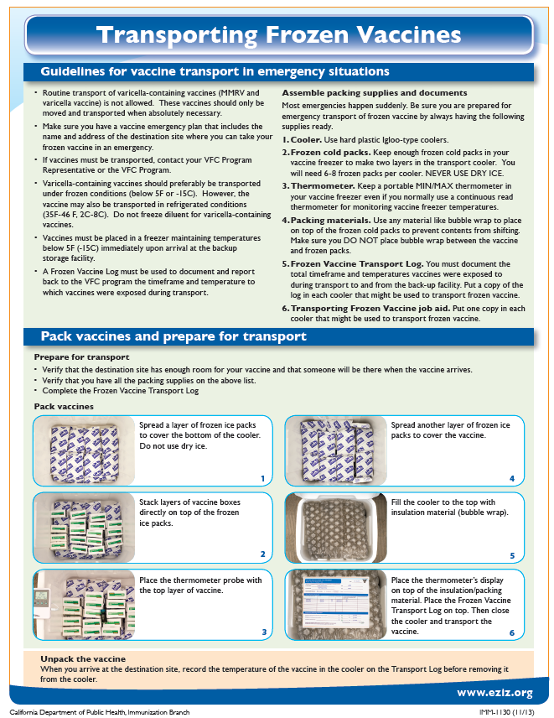
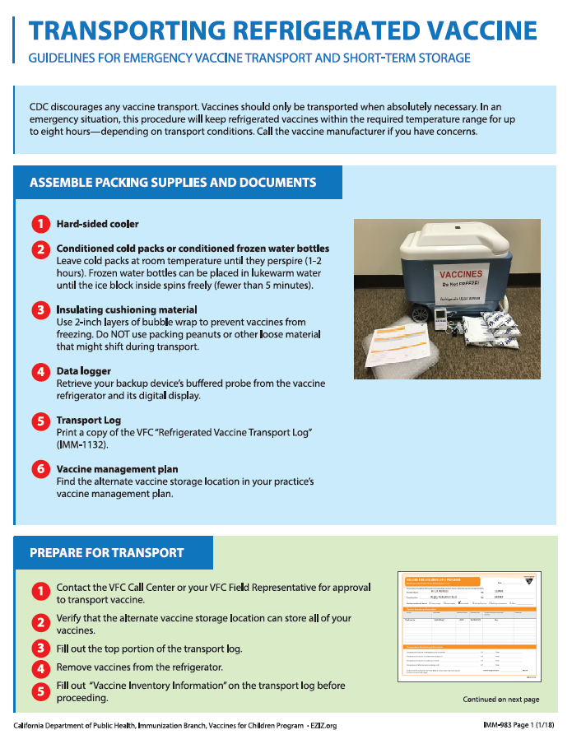
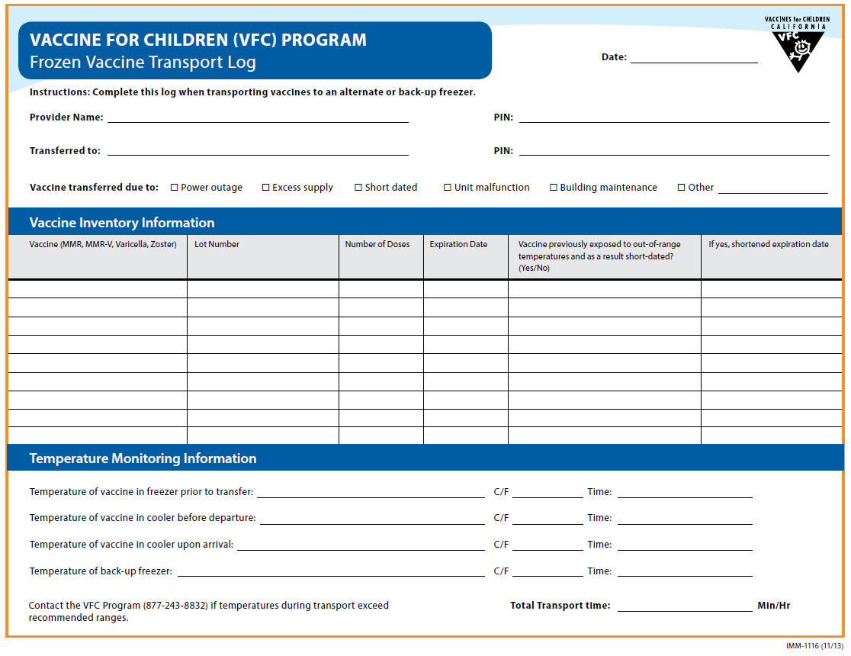
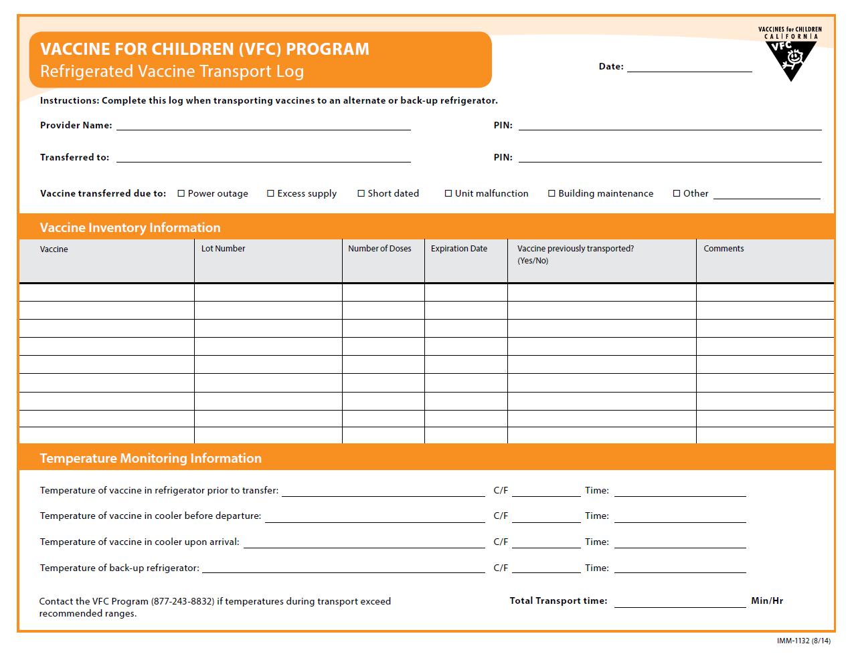
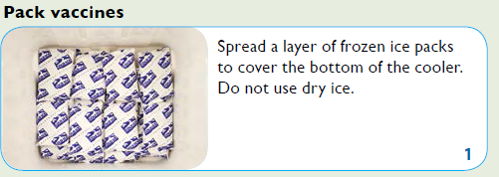
Vaccine Transfers
Notes:
Routine transferring of VFC vaccines between providers is not allowed
Providers must notify VFC of any transfers of VFC vaccines
Transfer of vaccines must be documented by completing the VFC Return/Transfer Form online
Log onto MyVFCVaccines account on eziz.org
Vaccines must be transported properly and temperatures must be monitored using the back-up data logger

Slide 58
Storage and handling incidents

Slide 59
Common Reasons S&H Incidents are Occurring
Discovered through:
Compliance Site Visits and Unannounced Storage and Handling Visits
Random Temperature Log Review
Provider initiated reports
Unit cycling
Conducting inventory
Storage unit malfunctions
Power outage
Unit set too cold/too warm
Unit unplugged
Door ajar
Temperatures not recorded
Vaccines left out/stored in the wrong unit
Notes:
How many resulted in revaccination recommendations
# of PINs reporting
# of cold excursions
# of warm excursions

Slide 60
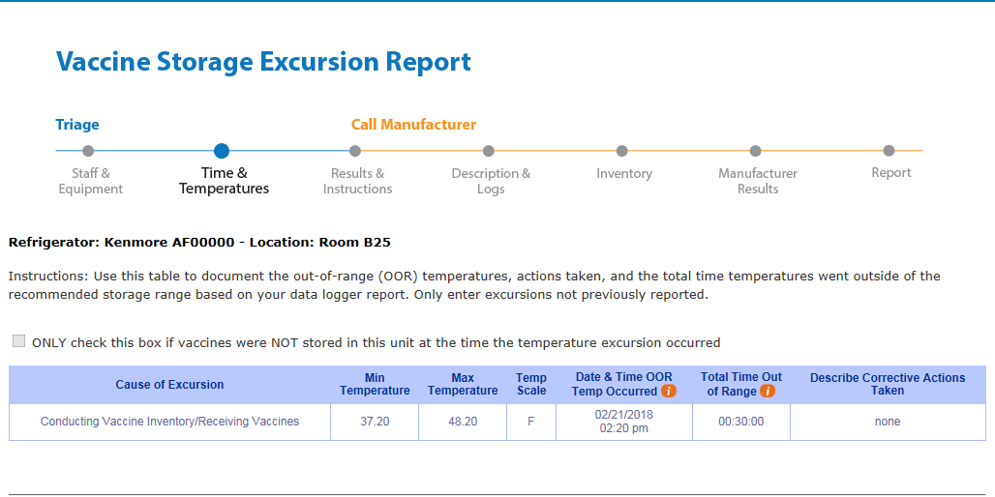
Storage and Handling Incidents
In 2017 alone, the VFC Program reviewed 1,600 S& H incidents
  Door left open
  Power outages
  Unit malfunction
  Temperature set too cold/too warm
  No temperatures recorded

Slide 61

Storage and Handling Temperature Excursions
If vaccine storage units are identified to be outside of the recommended temperature range, (temperatures excursions), providers must:
  Store vaccine under correct temperature storage conditions
  Label the vaccine “DO NOT USE” so the vaccine is not administered until a response indicating the vaccine is acceptable for use has been received
  Notify your clinic supervisor
  Document the excursion into VFC’s Storage and Handling Online Triage System (SHOTS)
  Contact individual vaccine manufacturers for a determination of vaccine viability if instructed

Slide 62



Documentation of temperature excursions
Providers document and report excursions via VFC’s Storage and Handling Online Triage System (SHOTS), accessible through MyVFCVaccines.org
Upon documentation of temperature excursion information, SHOTS guides providers on whether or not they can resume using their vaccines or if they need to contact vaccine manufacturers
This minimizes the need to call the VFC Customer Service Center or wait for open VFC business hours before taking action when a temperature excursion is discovered.
After entering a temperature excursion on SHOTS, providers receive specific recommendations and best practices for vaccine storage and handling to help prevent future excursions from occurring.

Slide 63

Active Temperature Monitoring
Temperature Log Review- Random provider selection upon order submission

Slide 64
When Would the VFC Program consider Vaccines spoiled
Temperatures not monitored and documented
No data logger reported available
Vaccines transported without a data logger
Log falsification

Slide 65
Talking Points for families should revaccination be recommended due to a storage and handling incident
Many children end up receiving additional doses of routine immunizations, most commonly after their immunization records have been lost, but also when they have received doses that are weakened after being stored too cold or too warm.
Receiving extra doses is recommended by national authorities (e.g., ACIP, AAP, AAFP) in these situations to make sure that children are protected against dangerous diseases.
The possible reactions that might occur after extra doses of vaccines are the same as those seen after the usual doses, such as temporary swelling and pain where the shot was injected. These possible reactions are described on the Vaccine Information Statements given during routine immunization.

Slide 66
Additional talking points on revaccination
Throughout our lives we are frequently exposed to germs that we have seen before, often by having no symptoms, sometimes by having mild symptoms, and sometimes by having a boost to our immune systems. An extra vaccine dose has similar effects.
Routine vaccines can require five or more doses in childhood. Repeating one of these doses is just as safe as receiving the next routine dose in the series.

Slide 67
Communication, Education & Training Opportunities

Slide 68


Provider Communications
The program has several formats for communicating different types of information with enrolled providers and clinic staff
  Program letters
    are the formal format for communicating critical program changes, requirements, new vaccines, recommendations, etc.
    Target audience: Providers
  FAX Blasts & Email Broadcasts
    are used to alert providers of critical communications, provide quick program updates, or share monthly VFC Tips on a variety of different topics
    Target Audience: Clinic managers, Vaccine Managers, MAs
  Order Confirmation & Order Approval E-mails
    are used to alert vaccine managers of vaccine shipments
    Target Audience: Vaccine Managers

Slide 69

EZ-IZ: One EZ Stop for lots of IZ Resources!
Platform for provider education, communication and completion of program requirements
Notes:
…..it all started with eziz!
69

Slide 70


VFC Afternoon TEAch
Afternoon TEAch with VFC is a new webinar series offered to California VFC program providers and their staff
  held at noon for an hour
  Online webinars will cover a variety of immunization topics to help VFC provider staff in daily immunization efforts
  Future webinars may will discuss:
    Pediatric vaccination schedule
    Adolescent vaccination schedule
    Injection safety and many more topics

Slide 71

2019 Storage & Handling Toolkit
https://www.cdc.gov/vaccines/hcp/admin/storage/toolkit/storage-handling-toolkit.pdf
Revisions include:
A reorganized layout with color coded sections to help better navigate the toolkit
Updated job aids and resource documents
Updated visuals for the vaccine storage and handling recommendations and best

Slide 72


CA 2019 Provider Operations Manual
Notes:
--Highlight 2019 e-version
Summary of 2019 Updates

Slide 73

2019 Immunization Schedules
CDC has released the 2019 adult and child/adolescent immunization schedule.
Along with the schedules, CDC is introducing:
  A schedule website redesign
  There is a link on the electronic version of the schedule to the full ACIP recommendation which also includes storage and handling administration and other relevant information for the vaccine

Slide 74
The World Health Organization (Who) publishes list of “Ten Threats to Global Health in 2019” : vaccine Hesitancy Makes the List

Slide 75
Questions?
Karen Turner
Chief, Field Services Section
CA Department of Public Health, Immunization Branch
Phone: (559) 228-5840
Cell: (559) 779-1788
Fax: (559) 228-5840
Karen.Turner@cdph.ca.gov

