Slide 1
School Immunization Requirements

Slide 2
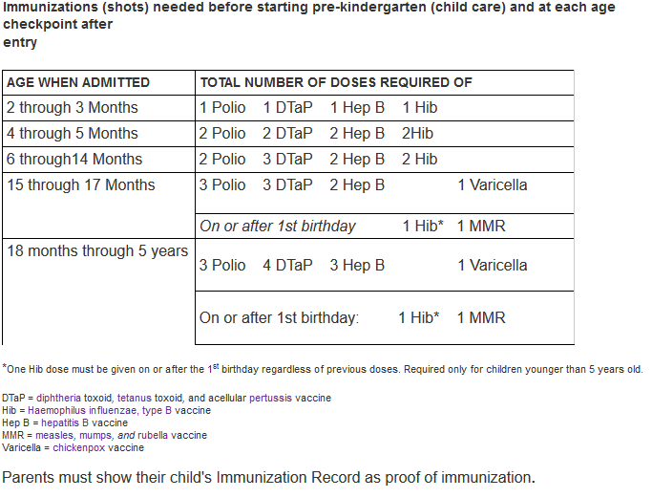
Parents’ Guide to Immunization Required for Pre-Kindergarten (Child Care) Staring July 1, 2019
l

Slide 3
Starting July 1, 2019 Students Admitted at TK/K-12 Need:
Diphtheria, Tetanus, and Pertussis (DTaP, DTP, Tdap, or Td) — 5 doses (4 doses OK if one was given on or after 4th birthday. 3 doses OK if one was given on or after 7th birthday.) For 7th-12th graders, at least 1 dose of pertussis-containing vaccine is required on or after 7th birthday.
Polio (OPV or IPV) — 4 doses (3 doses OK if one was given on or after 4th birthday)
Hepatitis B — 3 doses (not required for 7th grade entry)
Measles, Mumps, and Rubella (MMR) — 2 doses (Both given on or after 1st birthday)
Varicella (Chickenpox) — 2 doses
These immunization requirements also apply to students entering transitional kindergarten.
California schools are required to check immunization records for all new student admissions at TK/Kindergarten through 12th grade and all students advancing to 7th grade before entry. Parents must show their child's Immunization Record as proof of immunization.

Slide 5
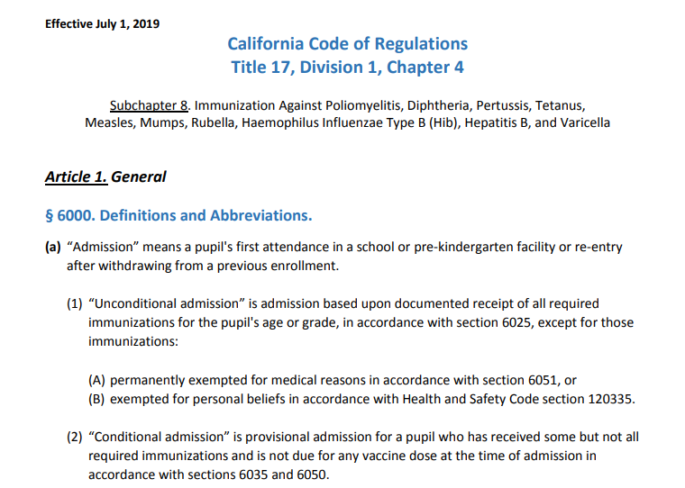
New Regulations Effective July 1, 2019
\
http://eziz.org/assets/docs/IMM-1080.pdf

Slide 6
Immunization Regulations 2019-2020 School Year changes will include
Requiring 2 (rather than 1 @ <13 years) doses of chickenpox vaccine at
Kindergarten entry
7th grade advancement
K-12 admission or transfer
Requiring 2 MMR doses and 3 Hepatitis B vaccine doses at admission or transfer more uniformly throughout K-12
age restrictions are removed

Slide 7
New TK/K-12 Admission Table

Slide 8
Immunization Regulations 2019-2020 School Year changes will include
Medical exemptions for new admissions may be signed only by a California-licensed MD/DO
Each temporary medical exemption may be issued for no more than 12 months.
The physical condition or medical circumstance for the exemption will need to be specified.

Slide 9
Steps schools can take now to prepare
Record all varicella vaccine doses for admissions on the Blue Card or School Information System
Compile lists of (at least) 6th grade students for 2018-2019 (likely 7th graders in 2019-2020) with no record of a 2nd dose of varicella vaccine – Use for reminders in 2019.
Check CAIR for additional doses not on file
Check ShotsForSchool.org for resources to use in registration packets for fall admission.

Slide 10
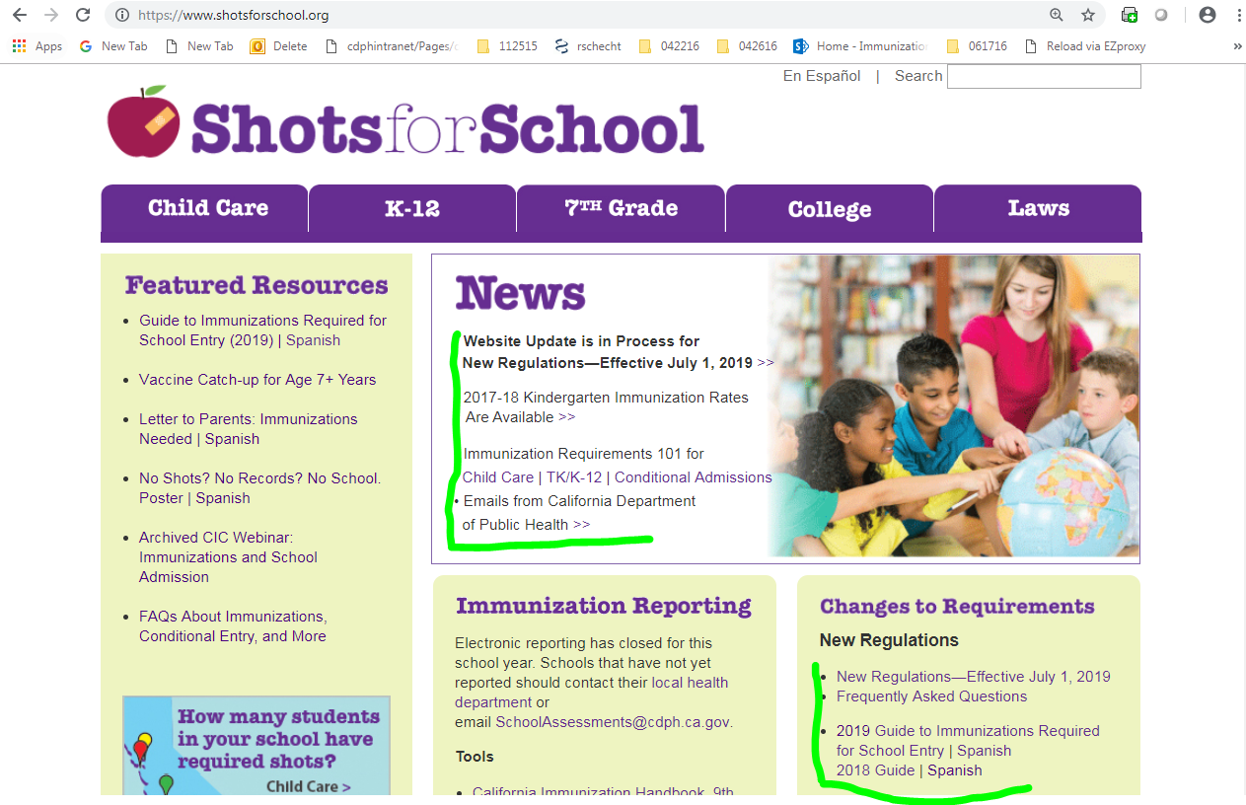
Updated resources…

Slide 11
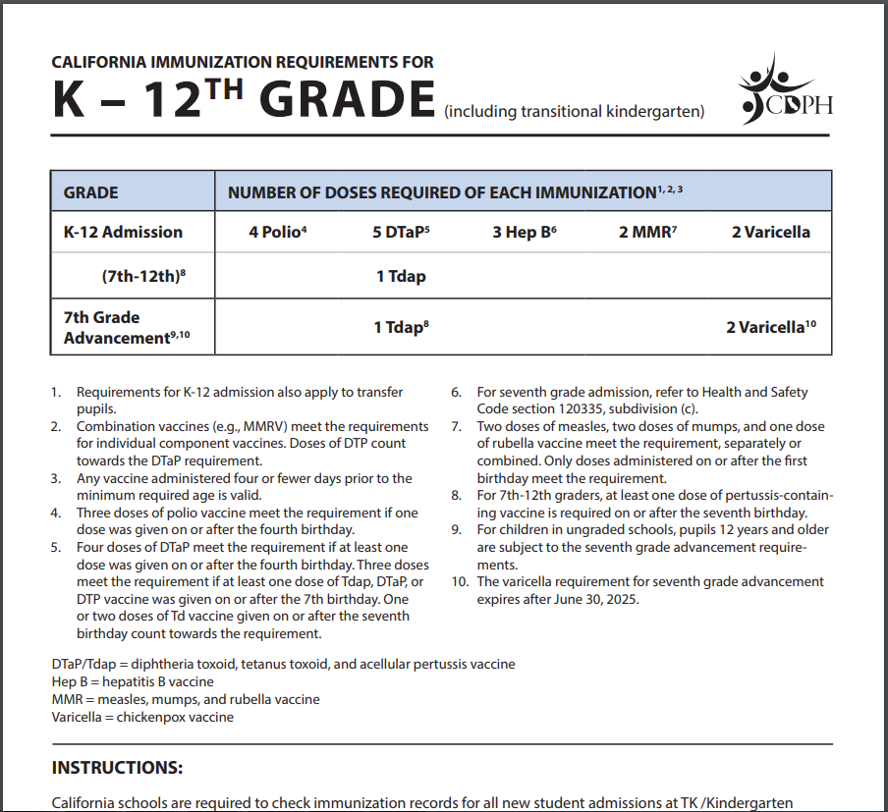
Materials for schools and parents…
Child care and school requirement materials at: www.shotsforschool.org
Email: info@shotsforschool.org
Notes:
Move this to the end?

Slide 12
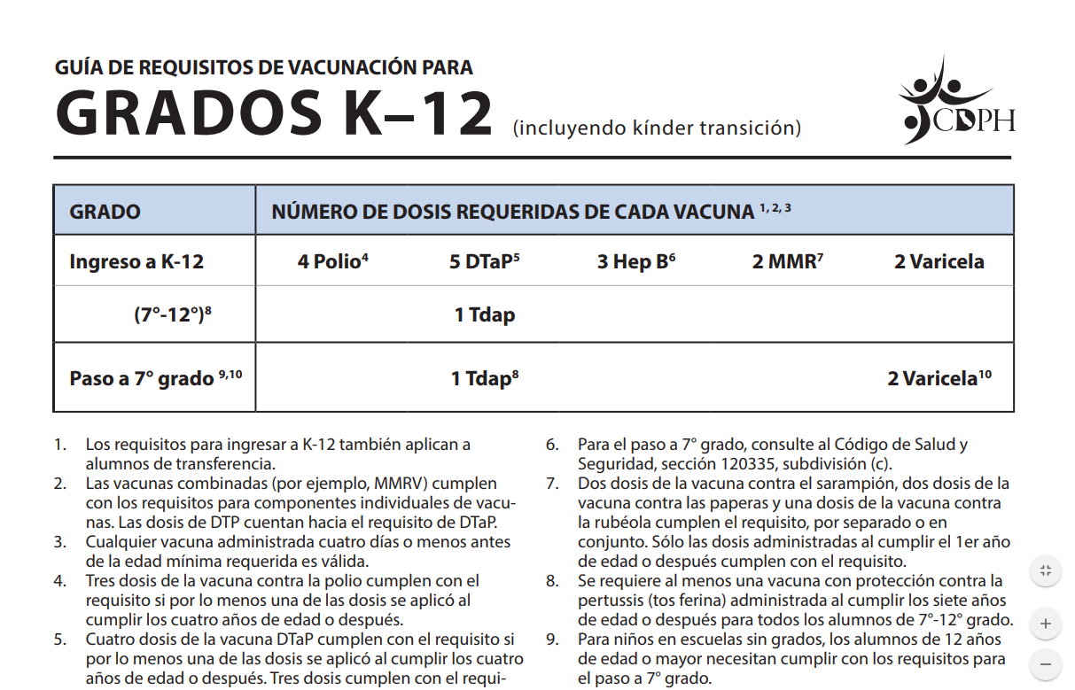
Materials for schools and parents…
Child care and school requirement materials at: www.shotsforschool.org
Email: info@shotsforschool.org
Notes:
Move this to the end?

Slide 13
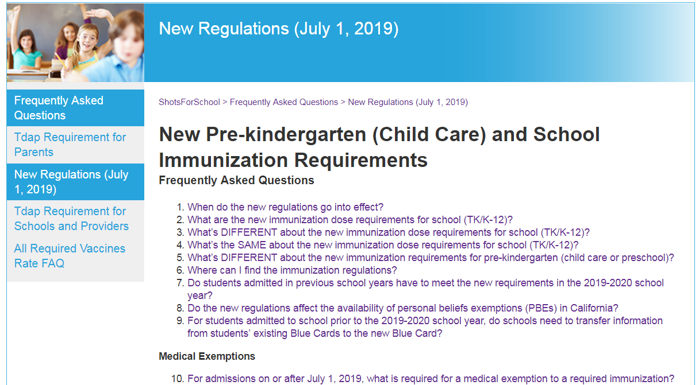
FAQs

Slide 14
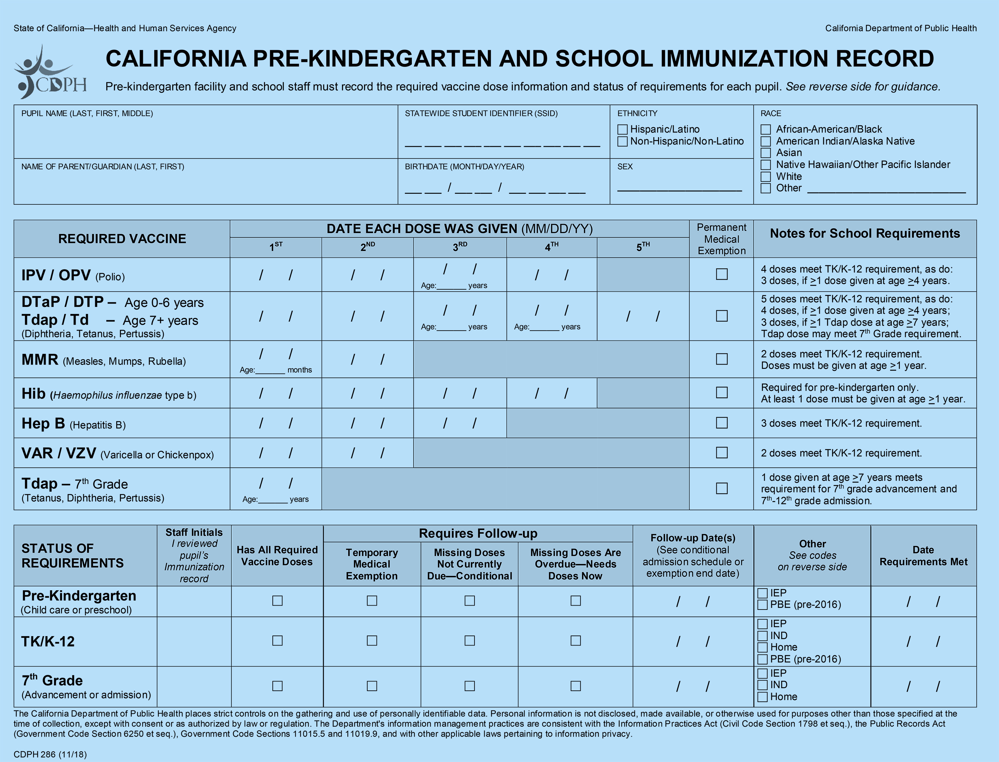
4 13 18
11
Notes:
Use timed reveals. Give example of what goes in the age section and compare to notes to show how easy it is.

Slide 15
In progress… Revised resources to support 2019-20 implementation
Immunization requirement schedules, guides
Blue Cards for recording doses –electronic version
12/18 webinar to be archived
Updates will be posted at www.shotsforschool.org and by email.

Slide 16
About Immunizations
What’s the difference between “Required” and “Recommended” immunizations?
Some, but not all recommended childhood vaccines are required by California law and regulations in order to attend school. Under the California School Immunization Law (California Health and Safety Code, Sections 120325-120375), to protect the public’s health, children are required to receive certain immunizations in order to attend public and private elementary and secondary schools, child care centers, family day care homes, nursery schools, day nurseries and developmental centers.
Not all recommended immunizations are required for school, but it is still important that children receive all of them. Talk to your doctor about other recommended vaccines, including flu vaccine every year.

Slide 17
What is the “recommended” immunization schedule?
The recommended schedule lists the age or age range when each vaccine or series of shots is recommended. The pediatric immunization recommendations in the United States are developed by the federal Advisory Committee on Immunization Practices (ACIP), typically in coordination with the American Academy of Pediatrics (AAP) and the American Academy of Family Physicians (AAFP).
What if I can’t afford vaccines or my insurance doesn’t cover them?
The California Vaccines for Children (VFC) Program provides vaccines for eligible children at no cost. Find a VFC provider in your area using the locator.
Underinsured children are eligible to receive VFC vaccine only through a Federally Qualified Health Center (FQHC), or a Rural Health Clinic (RHC) under an approved deputization agreement.
Many local health departments offer free or low-cost vaccines.
Your local pharmacy may also give Tdap and other vaccines for a fee.

