Slide 1
ACIP Updates
(June/October 2018)
Steven Vantine
Educational Consultant
State of California, Dept. of Public Health
Division of Communicable Disease Control
Immunization Branch
Version: 01.31.19RS

Slide 2
Overview
2019 Adult Immunization Schedule
2019 Pediatric/Adolescent Immunization Schedule
Hepatitis A – New Recommendations
Pneumococcal vaccine updates
HPV Vaccine
Pertussis vaccination
Vaccine Safety: Shoulder Injury After Injection

Slide 3
Disclosures
Speaker has no financial conflict with manufacturers of any product named in this presentation. The use of trade names and commercial sources during this presentation is for identification only, and does not imply endorsement by the U.S. Department of Health and Human Services, the U.S. Public Health Service, the Centers for Disease Control and Prevention or the State of California, Immunization Branch.

Slide 4
Objectives
Identify changes to the recommendations in the 2019 Immunization Schedule.
Identify changes to the ACIP Hepatitis A vaccination recommendations
Become knowledgeable about the proposed changes to the HPV age indications for vaccination
Discuss the possible changes to pertussis vaccination recommendations

Slide 5
2019 Immunization Schedule

Slide 6
2019 Immunization Schedule(s):
2019 version became available on February 8th
No real changes to the actual immunization schedule
Some formatting changes
Utilization of ‘Tables’ to breakdown schedules at-a-glance
Transition from complete sentences to bullets
Removal of unnecessary or redundant language
Increase of font size for easier reading
Formatting changes
Remove unnecessary text while preserving all pertinent information and maintaining clarity
https://www.cdc.gov/vaccines/schedules/hcp/imz/child-adolescent.html

Slide 7
2019 pediatric/adolescent Immunization schedule – vaccine list
https://www.cdc.gov/vaccines/schedules/hcp/imz/child-adolescent.html
Notes:
Immunizations are given according to “recommendations.”
The CDC publishes recommendations every year.
There are different schedules for children and adults. There’s also a catch-up schedule.
Make sure you have the current immunization schedules in your office.
Here is the schedule for children from birth to age 18.

Slide 8
2019 pediatric/adolescent Immunization schedule
https://www.cdc.gov/vaccines/schedules/hcp/imz/child-adolescent.html
Notes:
Immunizations are given according to “recommendations.”
The CDC publishes recommendations every year.
There are different schedules for children and adults. There’s also a catch-up schedule.
Make sure you have the current immunization schedules in your office.
Here is the schedule for children from birth to age 18.

Slide 9
2019 pediatric/adolescent Immunization schedule by medical condition
https://www.cdc.gov/vaccines/schedules/hcp/imz/child-adolescent.html
Notes:
Immunizations are given according to “recommendations.”
The CDC publishes recommendations every year.
There are different schedules for children and adults. There’s also a catch-up schedule.
Make sure you have the current immunization schedules in your office.
Here is the schedule for children from birth to age 18.

Slide 10
2019 adult immunization schedule – Vaccine list
https://www.cdc.gov/vaccines/schedules/downloads/adult/adult-combined-schedule.pd
Notes:
If a patient falls behind on their shots, the provider uses the catch-up schedule to get them up to date.
Trainer Note: Ask why it’s important for the patient to be up-to-date on their shots.

Slide 11
2019 adult immunization schedule
https://www.cdc.gov/vaccines/schedules/downloads/adult/adult-combined-schedule.pd
Notes:
If a patient falls behind on their shots, the provider uses the catch-up schedule to get them up to date.
Trainer Note: Ask why it’s important for the patient to be up-to-date on their shots.

Slide 12
2019 adult immunization schedule by medical condition
https://www.cdc.gov/vaccines/schedules/downloads/adult/adult-combined-schedule.pd
Notes:
If a patient falls behind on their shots, the provider uses the catch-up schedule to get them up to date.
Trainer Note: Ask why it’s important for the patient to be up-to-date on their shots.

Slide 13
Hepatitis A Disease

Slide 14
Hepatitis A Outbreaks – National
https://www.cdc.gov/hepatitis/outbreaks/2017March-HepatitisA.htm

Slide 15
Hepatitis A Person-to-Person Outbreak-Associated Cases, United States, August 1, 2016-June 18, 2018
California
County (outbreak onset date) | Cases | Hospitalizations | Deaths
San Diego (Nov 2016) | 588 | 403 (68%) | 20 (3.4%)
Other (76 cases in Santa Cruz) | 117 | 59 | 1
Total | 705 | 462 | 21
Other states with outbreaks of >100 cases
State (outbreak onset date) | Cases | Hospitalizations | Deaths
Michigan (Aug 2016) | 856 | 692 (81%) | 27 (3.2%)
Utah* (Jan 2017) | 259 | 138 (53%) | 2
Kentucky* (Aug 2017) | 964 | 566 (59%) | 6
Indiana* (Nov 2017) | 202 | 93 (46%) | 0
West Virginia* (Jan 2018) | 451 | 303 (67%) | 1
*Linked epidemiologically and/or via viral sequencing to California cases
Notes:
https://www.michigan.gov/mdhhs/0,5885,7-339-71550_2955_2976_82305_82310-447907--,00.html
http://health.utah.gov/epi/diseases/hepatitisA/HAVoutbreak_2017
https://chfs.ky.gov/agencies/dph/Pages/default.aspx
https://www.in.gov/isdh/27791.htm
https://dhhr.wv.gov/oeps/disease/viral-hepatitis/pages/hepA_outbreak.aspx

Slide 16
Update on California Hepatitis A Outbreaks
With the slowdown in reported hepatitis A cases across California, CDPH has demobilized the outbreak response and continues to monitor reported hepatitis A cases statewide.
To date, San Diego and Santa Cruz have reported the greatest number of cases.
The majority of people who have been infected with hepatitis A virus in this outbreak are people experiencing homelessness and/or using illicit drugs in settings of limited sanitation.
Other states are experiencing outbreaks in similar populations of at-risk people.
Intensive efforts by LHD’s and their clinical and community partners, the number of reported outbreak-associated cases has substantially decreased in California.
https://www.cdph.ca.gov/Programs/CID/DCDC/Pages/Immunization/Hepatitis-A-Outbreak.aspx

Slide 17
ACIP Recommendations
The Advisory Committee on Immunization Practices (ACIP) recommends that the following persons be vaccinated against hep A:
All children at age 1 year,
Persons who are at increased risk for infection,
Persons who are at increased risk for complications from hepatitis A, and
Any person wishing to obtain immunity (protection).
https://www.cdc.gov/vaccines/acip/meetings/downloads/slides-2017-06/hepatitis-04-nelson.pdf

Slide 18
ACIP Recommendations (cont.):
Persons at increased risk for Hepatitis A infection:
Persons traveling to or working in countries that have high or intermediate endemicity of hepatitis A.
Men who have sex with men
Users of injection and non-injection drugs.
Persons who have occupational risk for infection
Persons who have chronic liver disease
Household members and other close personal contacts of adopted children newly arriving from countries with high or intermediate hepatitis A endemicity.
Persons with direct contact with persons who have hepatitis A
https://www.cdc.gov/hepatitis/hav/havfaq.htm#vaccine

Slide 19
ACIP Recommendations (cont.):
Hepatitis A vaccines should be administered for post-exposure prophylaxis for all persons aged ≥12 months.
In addition to hepatitis A vaccine, immune globulin may be administered to persons aged >40 years depending on the providers’ risk assessment.
Hepatitis A vaccine should be administered to infants aged 6-11 months traveling outside the United States when protection against hepatitis A is recommended.
October 2018 ACIP - All persons aged 1 year and older experiencing homelessness should be routinely immunized against hepatitis A
https://www.cdc.gov/vaccines/acip/hepatitis_A

Slide 20
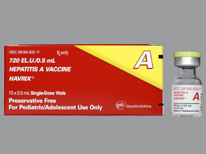
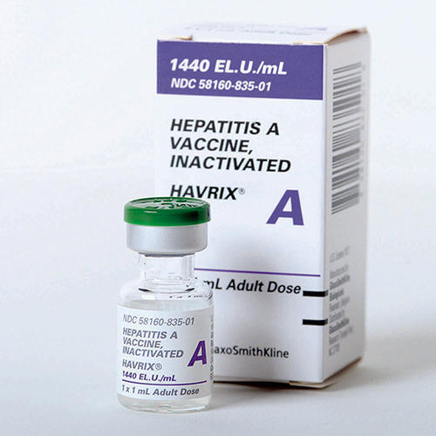
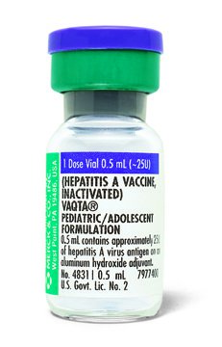
Dosage and Schedules for Hepatitis A Vaccine
https://www.cdc.gov/hepatitis/hav/havfaq.htm#vaccine

Slide 21
Dosage and Schedules for Hepatitis A Vaccine
https://www.cdc.gov/hepatitis/hav/havfaq.htm#vaccine

Slide 22
Human Papilloma Virus

Slide 23
How do people get HPV?
HPV is transmitted through intimate skin-to-skin contact.
You can get HPV by having vaginal, anal, or oral sex with someone who has the virus.
It is most commonly spread during vaginal or anal sex.
HPV is so common that nearly all men and women get it at some point in their lives.

Slide 24
How do people get HPV?
HPV can be passed even when an infected person has no signs or symptoms.
You can develop symptoms years after being infected, making it hard to know when you first became infected.
In most cases, HPV goes away on its own and does not cause any health problems.
When HPV does not go away, it can cause health problems like genital warts and cancer.

Slide 25
Disease Burden of
HPV-Associated Cancers

Slide 26
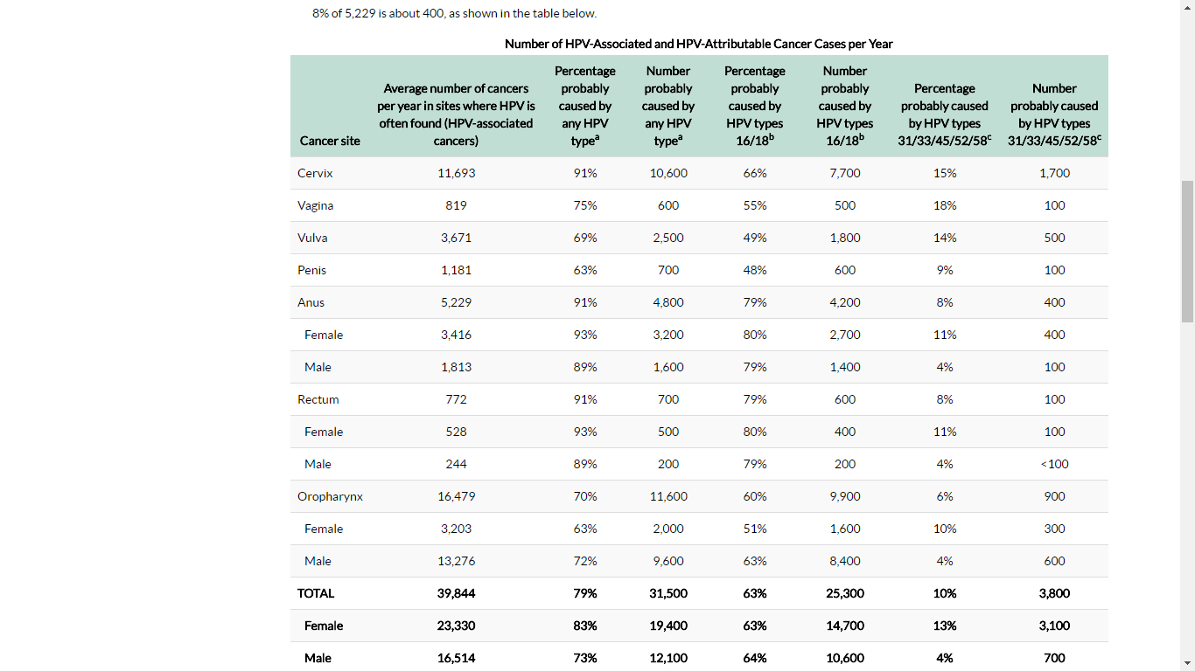
HPV Disease Burden (US data, 2010-2014)
https://www.cdc.gov/cancer/hpv/statistics/cases.htm

Slide 27
HPV Vaccines:
The vaccine first became available in June of 2006
HPV vaccines are highly immunogenic.
All HPV vaccines have been found to have high efficacy (close to 100%) for prevention of HPV
Quadrivalent vaccine was also found to have high efficacy (99%) for prevention of genital warts.
Quadrivalent vaccine also demonstrated high efficacy was also in among men who have sex with men (MSM).
Prior infection with one HPV vaccine type did not diminish efficacy of vaccine against the other HPV vaccine types
https://www.cdc.gov/vaccines/vpd/hpv/hcp/vaccines.html

Slide 28
ACIP HPV Vaccine Recommendations
Routine HPV vaccination at 11-12 years
As early as 9 years (Recommended for children with history of sexual abuse or assault.)
Females 13-26 years and males 13-21 years if not adequately vaccinated previously
Males 22-26 years may be vaccinated
Men who have sex with men*, transgender persons, or immunocompromised persons (including those with HIV) 22-26 years if not adequately vaccinated
*Including men who identify as gay or bisexual, or who intend to have sex with men.
http://www.cdc.gov/mmwr/pdf/wk/mm6411.pdf
Notes:
Routine HPV vaccination continues to be recommended at age 11-12 years, and may be given as early as 9 years of age.
Catch-up vaccination is also recommended for…
I want you to think about what the guidelines say. The idea of giving 2 doses at 11 or 12 is what it means to give the vaccine ON TIME. That’s according to guidelines. That’s when the vaccine is most effective. That’s when the body’s immune system mounts the strongest response. Giving the vaccine at older ages is LATE.
(animation) It’s not just the ACIP and CDC - the American Academy of Family Physicians, American Academy of Pediatricians, American College of Obstetricians and Gynecologists, and more all stand behind universal and timely vaccination.

Slide 29
HPV Vaccine Recommendations
# Doses | Recommended Dosing Schedule | Population
2 | 0, 6-12 months¹ | Persons initiating vaccination at age 9 through 14 years, except immunocompromised persons²
3 | 0, 1-2, 6 months³ | Persons initiating vaccination at age 15 through 26 years Immunocompromised persons² initiating vaccination at 9 through 26 years
¹ In a 2-dose schedule of HPV vaccine, the minimum interval is 5 months between the 1st and 2nd dose.
² Persons with primary or secondary immunocompromising conditions that might reduce cell-mediated or humoral immunity.
³ In a 3-dose schedule, the minimum interval between the 1st and 2nd dose is 4 weeks, 12 weeks between the 2nd and 3rd dose, and 5 months between the 1st and 3rd dose.
Notes:
Who is supposed to get the 2-dose schedule? It’s based on when the person starts the HPV vaccine series.
Anyone who starts the series at age 9-14 years, that’s anytime before their 15th birthday, as long as they are immunocompetent, is recommended to receive the 2 dose series. They should receive their 2nd dose 6-12 months after the first dose.
For those starting the series later at 15-26 years, they are recommended to receive the 3 dose series. The 2nd dose should be administered 1-2 months after the 1st, and the 3rd 6 months after the 1st. Immunocompromised people are also recommended to get the 3 dose schedule regardless of their age.
One thing of note to understand is the minimum interval. As you are scheduling patients, you should always use the recommended schedule of 0, 6-12 months and 0, 1-2 months, and 6 months. But you may be seeing patients who have gotten 1 or 2 doses in the past, and it’s important to look back and make sure they meet the minimum interval to be sure their series is valid.
For those starting the 2-dose schedule at 9-14 years of age, the minimum interval between the 1st and 2nd dose is 5 months.
For those starting the 3-dose schedule, the minimum interval between 1st and 2nd dose is 4 weeks, and the minimum interval between the 2nd and 3rd dose is 12 weeks. The minimum interval between the 1st and 3rd dose is 5 months.
There is no maximum interval between doses. The series never needs to be restarted due to delay.

Slide 30
Reminder: Other Guidance
9vHPV vaccine may be used to continue or complete a series started with another HPV vaccine.
If the series is interrupted, the series does not need to be restarted.
Number of doses based on age at initiation of series.
http://www.cdc.gov/mmwr/pdf/wk/mm6411.pdf

Slide 31
https://www.cdc.gov/vaccines/acip/meetings/downloads/slides-2018-02/HPV-04-Markowitz-508.pdf

Slide 32
https://www.cdc.gov/vaccines/acip/meetings/downloads/slides-2018-02/HPV-04-Markowitz-508.pdf

Slide 33
Harmonization of HPV Schedules:
February 2018 ACIP discussion: harmonize schedules
Would simplify immunization schedule
Might facilitate reaching males, including high risk males
Preliminary data suggests male HPV vaccination rates are lower in males than in females
Studies being conducted to determine the benefit of harmonizing schedules
https://www.cdc.gov/vaccines/acip/meetings/downloads/slides-2018-02/HPV-04-Markowitz-508.pdf

Slide 34
Harmonization of HPV Schedules:
https://www.cdc.gov/vaccines/acip/meetings/downloads/slides-2018-02/HPV-04-Markowitz-508.pdf

Slide 35
Harmonization of HPV Schedules:
https://www.cdc.gov/vaccines/acip/meetings/downloads/slides-2018-02/HPV-04-Markowitz-508.pdf

Slide 36
Second Dose Pertussis Vaccine

Slide 37
https://www.cdc.gov/vaccines/acip/meetings/downloads/slides-2018-10/Pertussis-02-Havers-508.pdf

Slide 38
https://www.cdc.gov/vaccines/acip/meetings/downloads/slides-2018-10/Pertussis-02-Havers-508.pdf

Slide 39
https://www.cdc.gov/vaccines/acip/meetings/downloads/slides-2018-10/Pertussis-02-Havers-508.pdf

Slide 40
https://www.cdc.gov/vaccines/acip/meetings/downloads/slides-2018-10/Pertussis-02-Havers-508.pdf

Slide 41
https://www.cdc.gov/vaccines/acip/meetings/downloads/slides-2018-10/Pertussis-02-Havers-508.pdf

Slide 42
https://www.cdc.gov/vaccines/acip/meetings/downloads/slides-2018-10/Pertussis-02-Havers-508.pdf

Slide 43
https://www.cdc.gov/vaccines/acip/meetings/downloads/slides-2018-10/Pertussis-02-Havers-508.pdf

Slide 44
https://www.cdc.gov/vaccines/acip/meetings/downloads/slides-2018-10/Pertussis-02-Havers-508.pdf

Slide 45
https://www.cdc.gov/vaccines/acip/meetings/downloads/slides-2018-10/Pertussis-02-Havers-508.pdf

Slide 46
https://www.cdc.gov/vaccines/acip/meetings/downloads/slides-2018-10/Pertussis-02-Havers-508.pdf

Slide 47
Questions?

Slide 48
Steven J. VanTine
Educational Consultant, Immunization Branch Division of Communicable Disease Control, Center for Infectious Diseases California Department of Public Health Office: 510.412.1593 Email: steven.vantine@cdph.ca.gov

