Slide 1
2019 Statewide Medical & Health Exercise (SWMHE) in Ventura County
Final Planning Meeting

Slide 2
Welcome
Housekeeping
Cords for televisions
Restrooms
Before the Exercise
Day of Exercise

Slide 3
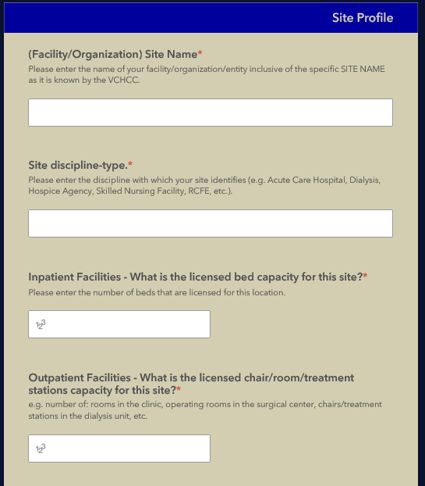
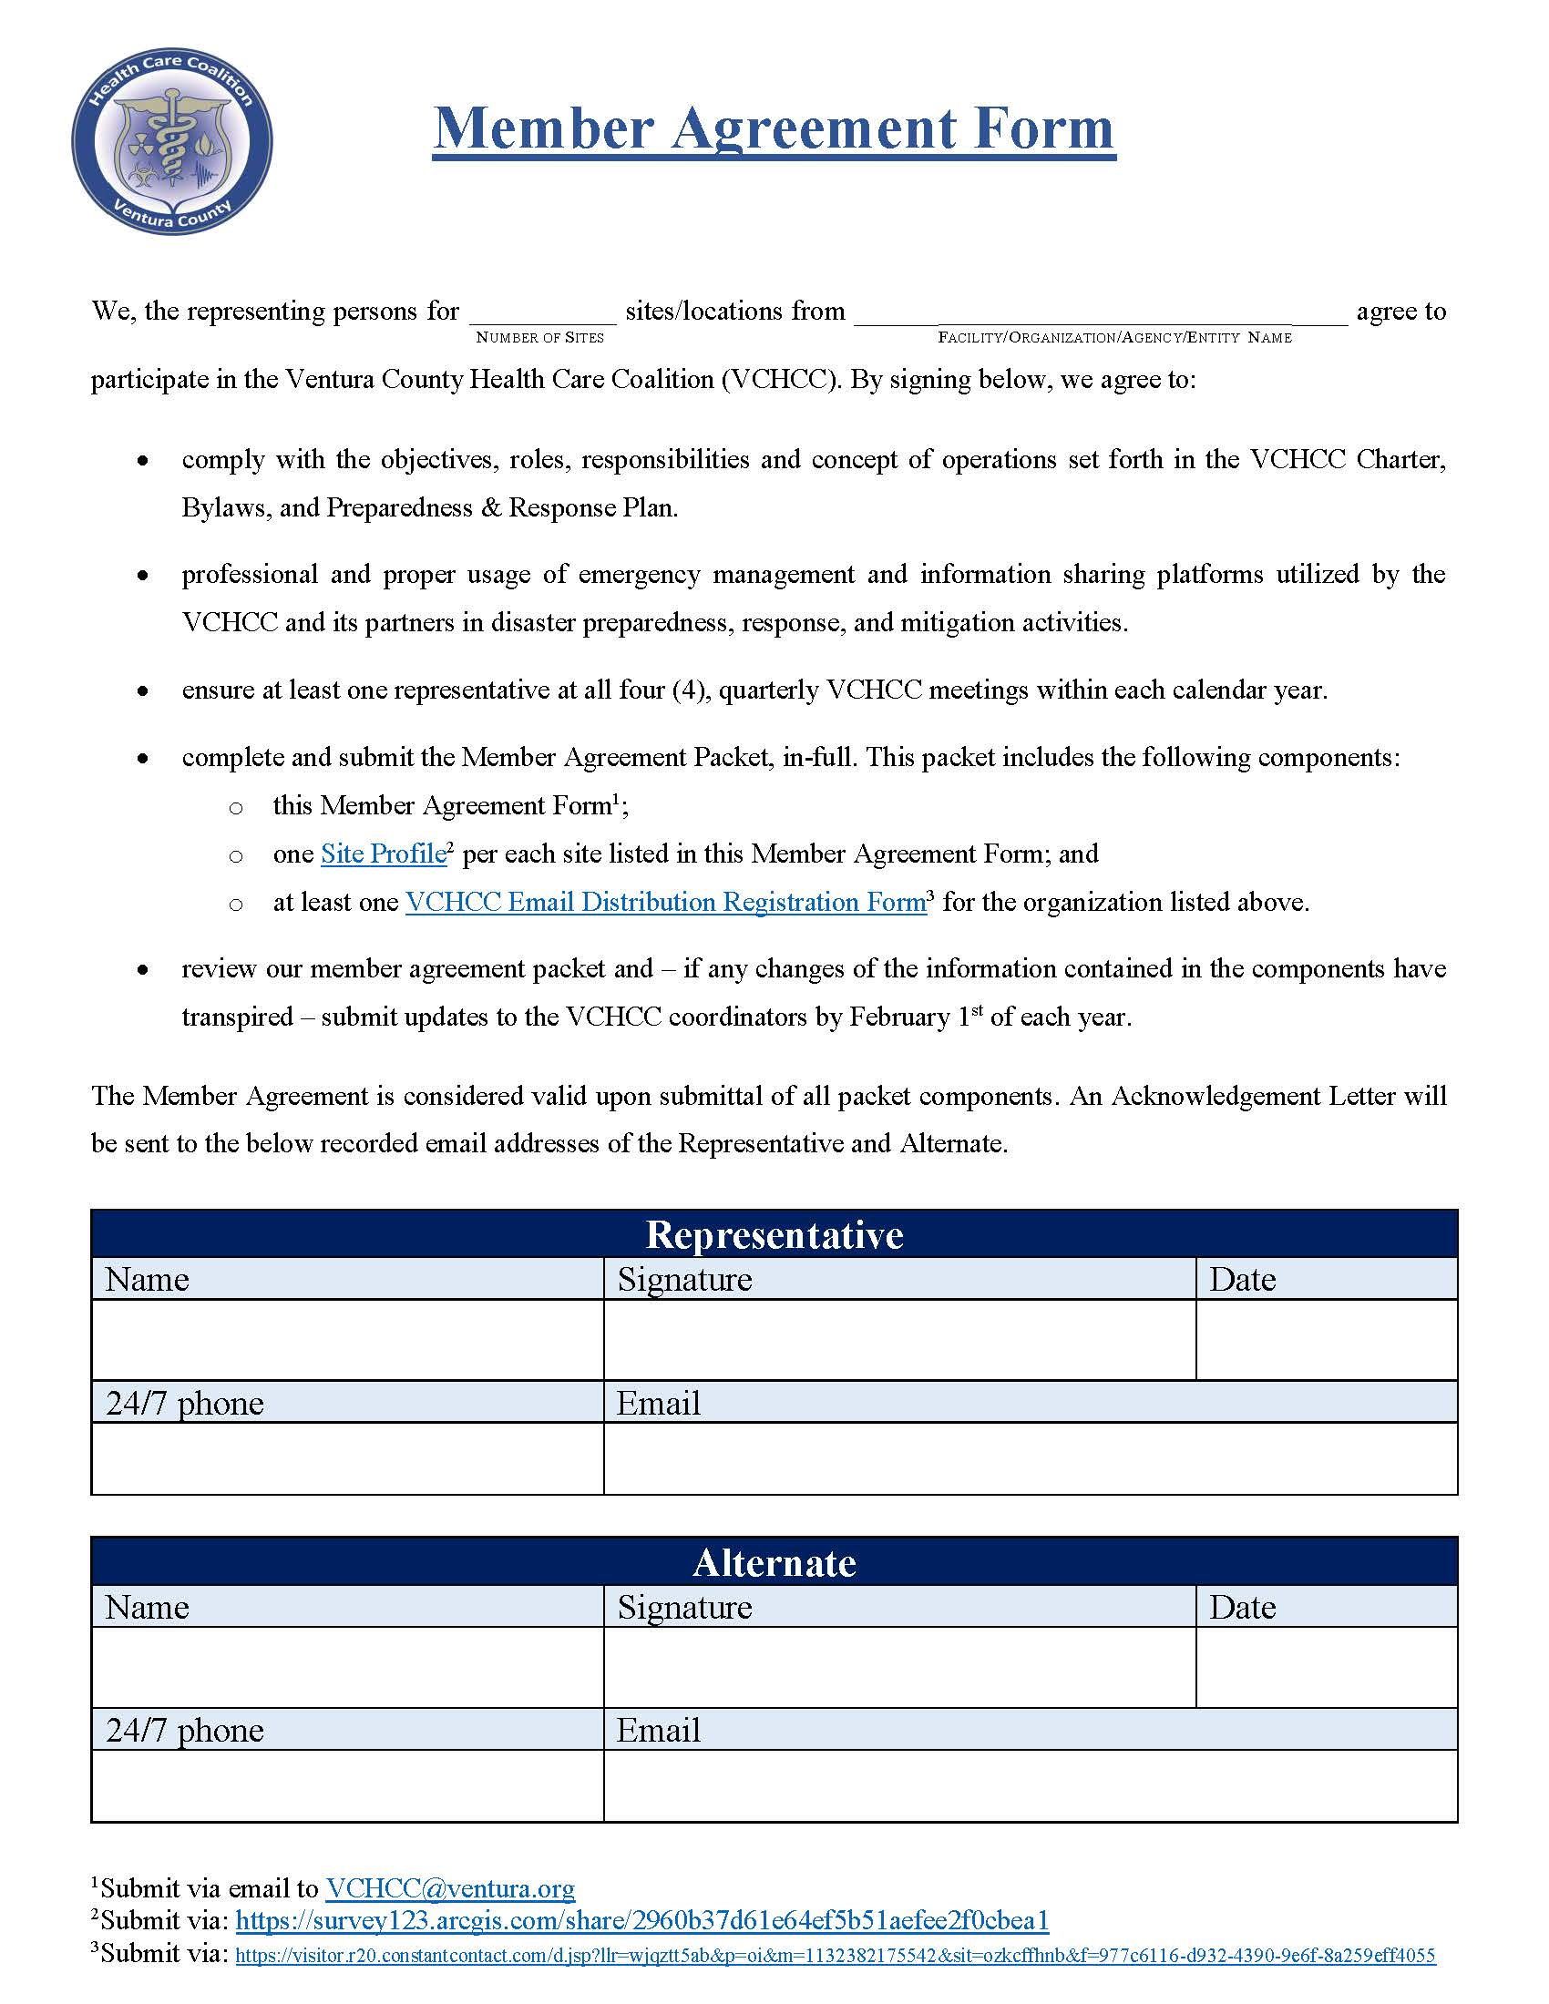
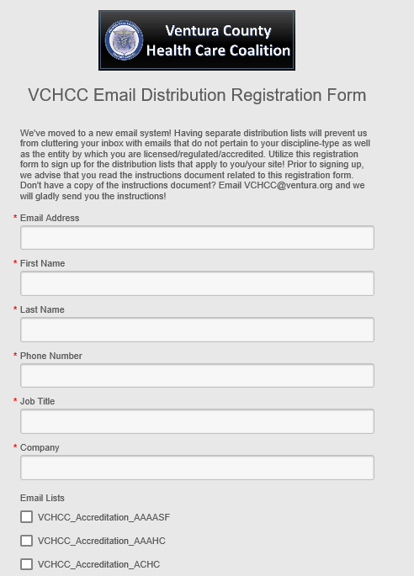
VCHCC Member Agreement Packet
All 3 components need to be complete by October 18th in order to receive Certificate of Participation.

Slide 4
OPTIONAL Before the Exercise
Create Paper Patients
work with Controller & Evaluator to integrate patients into MSEL & EEG
Add Internal Objectives
work with Controller & Evaluator to integrate patients into MSEL & EEG
include in ExPlan

Slide 5
Before the Exercise
Choose your Scenario
3 different MSELs to chose from
Ensure that Players know how to submit a SitRep
Review ExPlan
Roles (Section 2 of exercise webpage)
Print (Section 7 of the exercise webpage)
Exercise in Progress Signs → posted in exercise area at your site
Sign-In Sheet → every participant at your site needs to sign in
Player Handouts → provided to Players at sign-in
Player Activity Logs (ICS 214), if applicable → provided to Players at sign-in or briefing

Slide 6
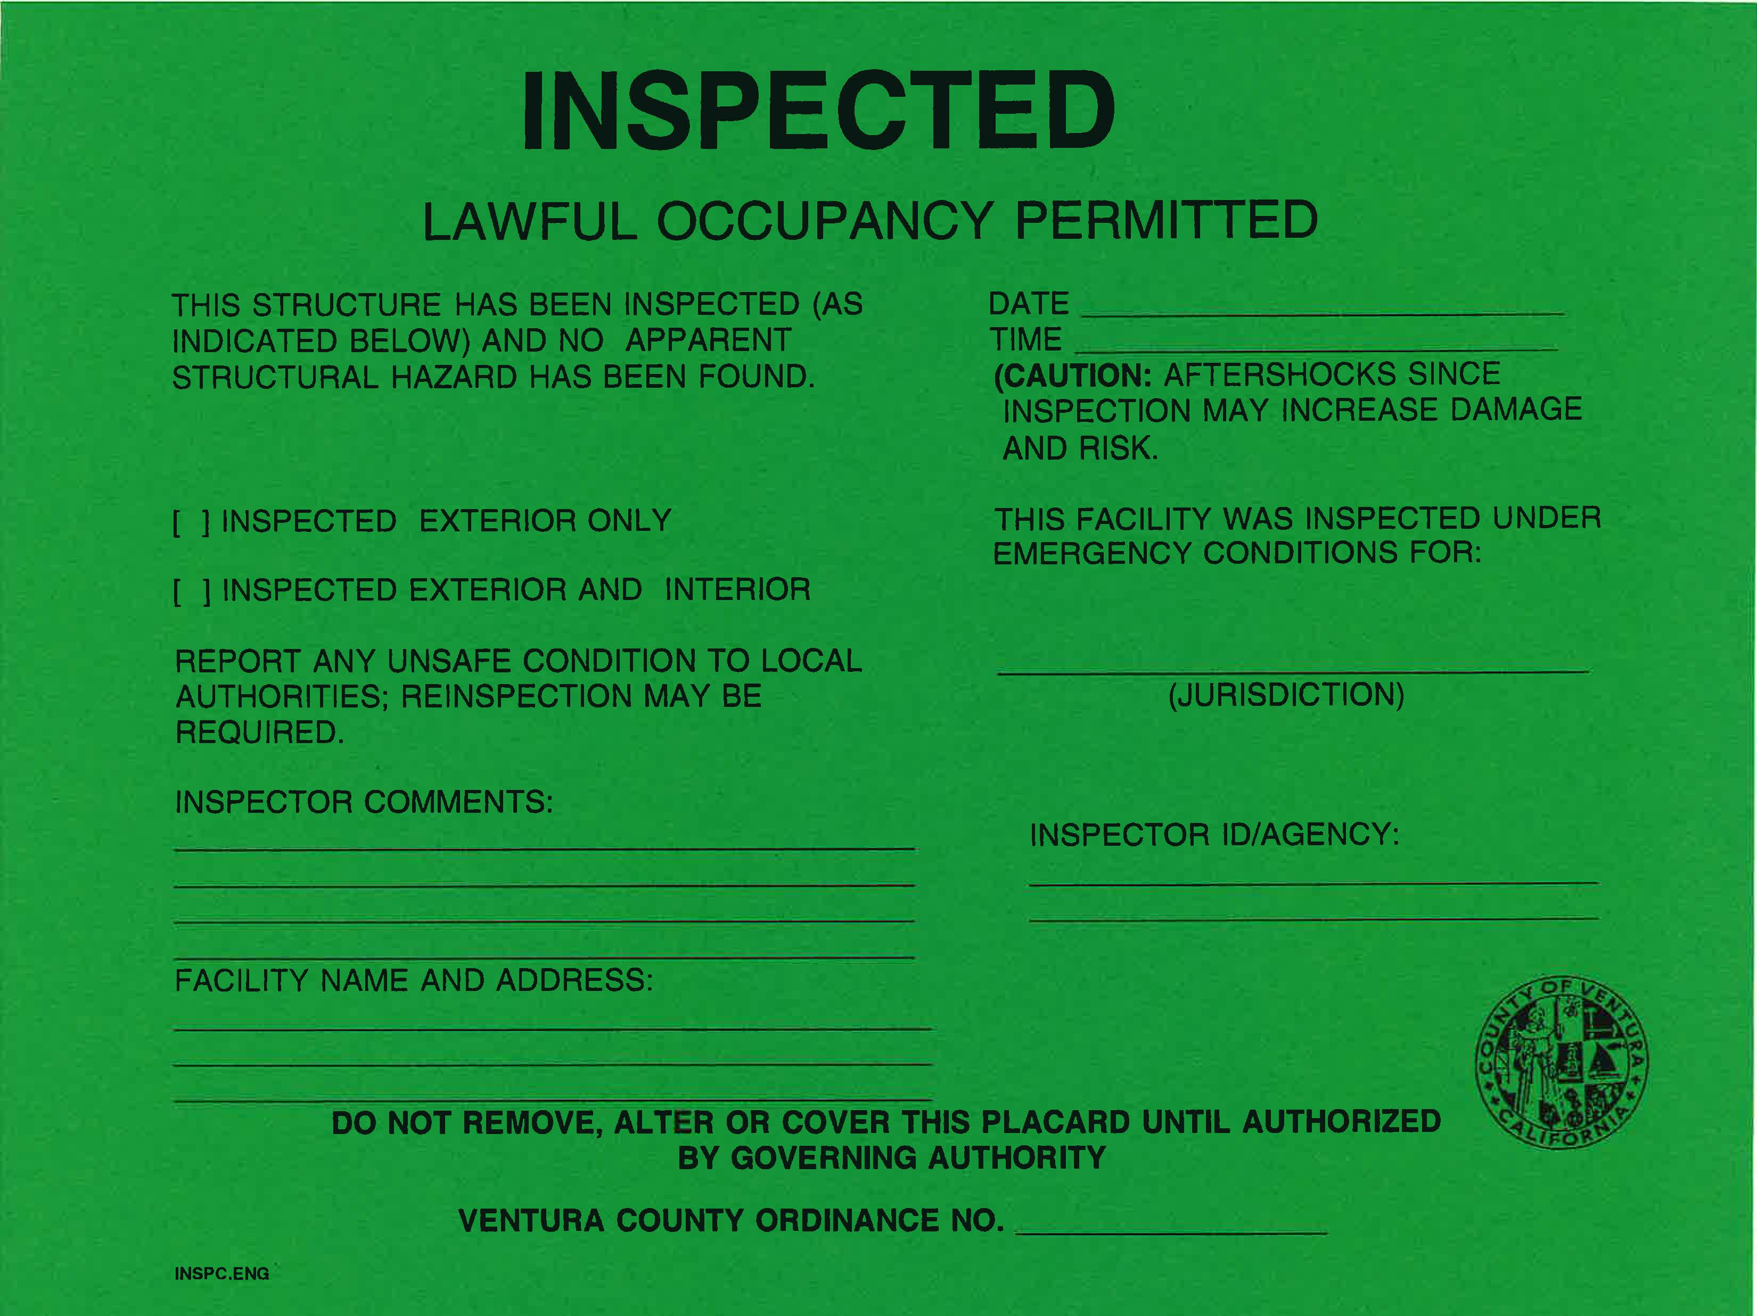
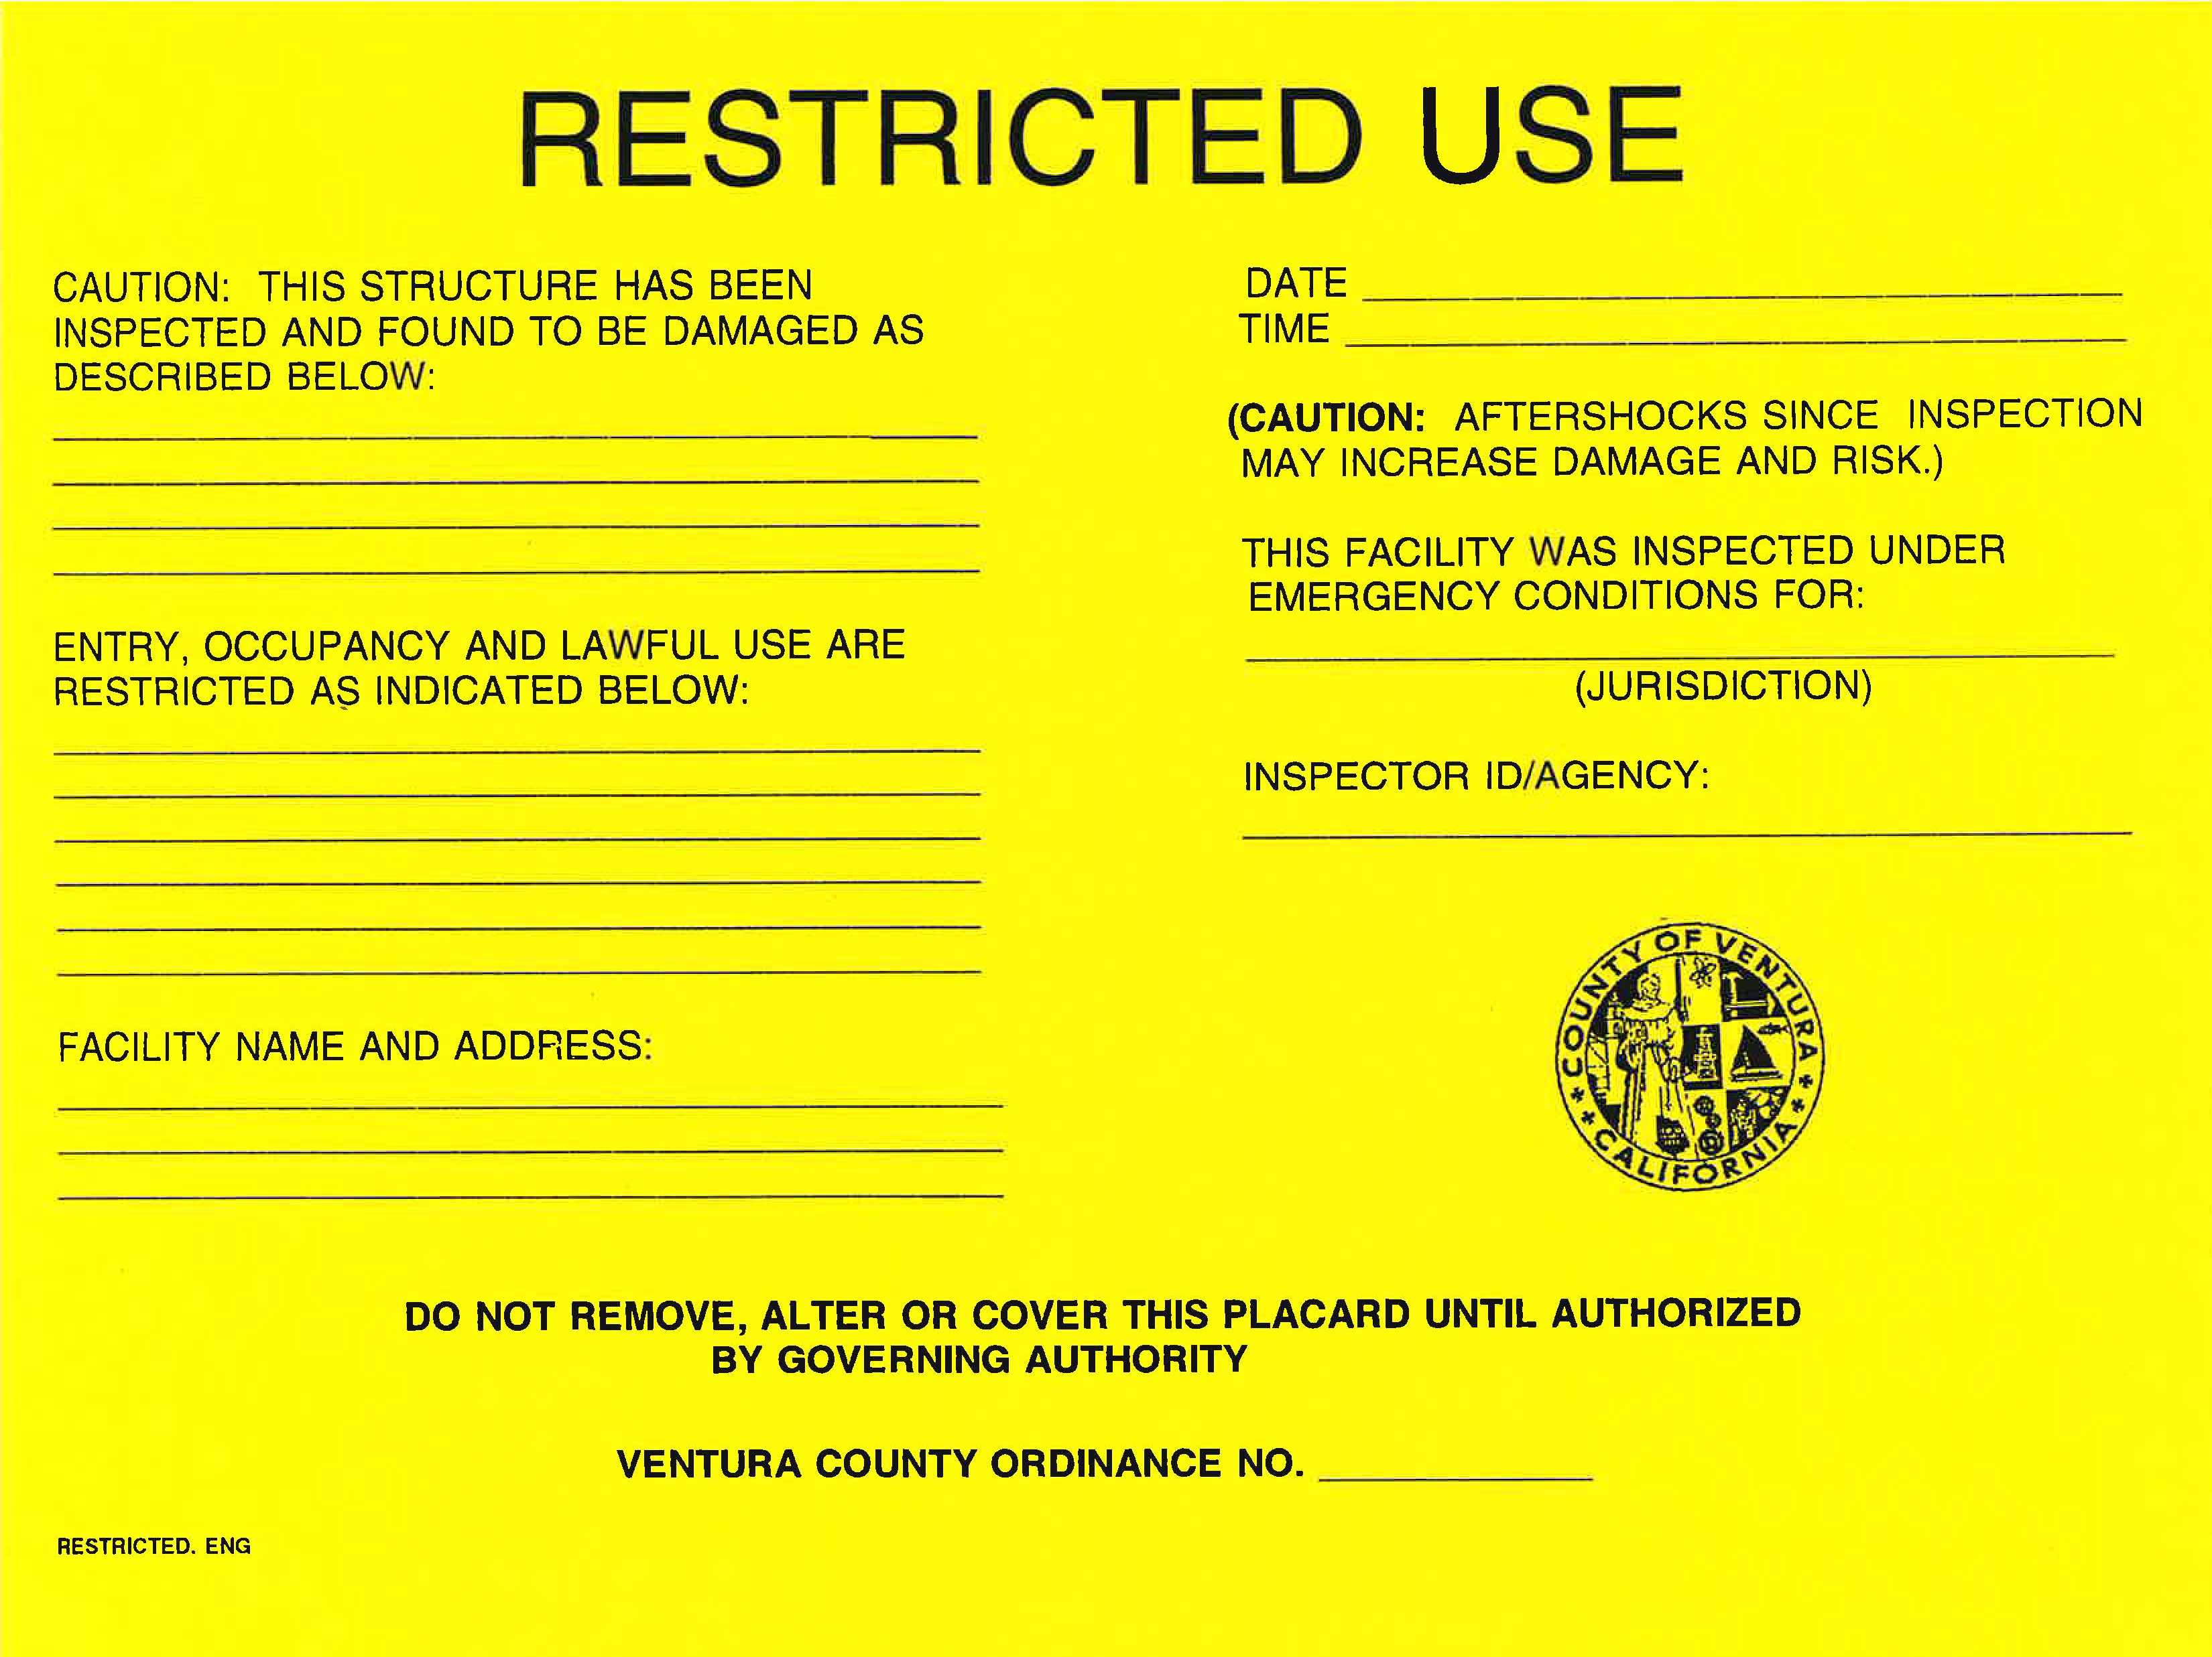
Choosing Scenario Building Safety Evaluation Forms
All 3 forms are provided in C/E packet, but only need to pick one:
No visible damage considerations may include future reports of unsafe conditions, repairs, or reinspection/further analysis.
Partial damage considerations may include restricted use such as: no access to specific areas, brief entry to areas, etc.
Significant damage considerations may include cascading events such as: partial collapse or damage to the building, utility failure, pollution/contamination (e.g. air quality or water), fire, explosion, chemical spill, etc.

Slide 7
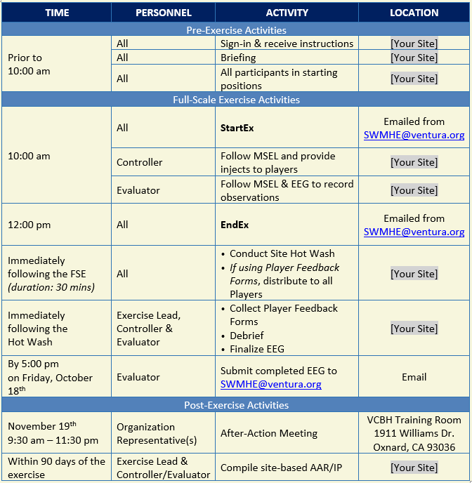
SCHEDULE

Slide 8
Execution: day of the exercise
Sign-In
Facilitated at each site
ALL Players & Roles need to attend
Play
Two hours of Exercise Play
Will be announced via email on 10/17 as “StartEx” and “EndEx”
Follow MSEL (Controller) & fill out EEG (Evaluator)
Available for download under section 7 on the exercise webpage
Briefing (30 mins)
Provide to Players:
Player Handouts
ICS 214, if applicable
Submit SitReps via bit.ly/vcsitrep2019
Use Briefing PPT as guidance
Notes:
PLAY
Only 2 emails we will send during play → everything else is provided in the Controller/Evaluator Packet as Inject Supplementals
Follow MSEL at the pace you need to → we are advising C/Es that they allow for more time for injects if need be and to move on to next inject if done early

Slide 9
Questions During Exercise Play
PARTICIPATING AGENCY | NUMBER/EMAIL
DOC | (805) 988-4089
Design Team Office | (805) 981-5301
Design Team Exercise lead | (805) 981-5331 (805) 981-5335 SWMHE@ventura.org

Slide 10
Situation Status Report (SitRep)
NEW link…will change January 1st of every year (given no current activation at that time)
Suggestions from July meeting are being vetted
Provide further input, post exercise (EEGs)
Copy of submitted SitRep is emailed to Report Creator
Bit.ly/vcsitrep2019

Slide 11
Execution: wrap-up activities
Immediately following the “End Ex”, each site should:
Hot Wash (30 mins)
Facilitated at each site
Exercise Lead, Controller & Evaluator Debrief
Submit EEG
Email completed EEG
Use Hot Wash PPT as guidance
Assist Evaluator with EEG
Available for download under section 7 on the exercise webpage
to SWMHE@ventura.org
with the subject line “2019 EEG_[name of your site]”
by 5:00 pm on, Friday, October 18^{th.}
Review player feedback forms, if applicable

Slide 12
Tomorrow’s Controller & Evaluator Training
All Controllers & Evaluators will be provided detailed information regarding:
MSEL
Injects
Building Safety Evacuation Forms
Adding patients / internal objectives
EEG
Hot Wash
1:30 pm – 3:00 pm
2240 E Gonzales Rd. Suite 200
Oxnard, CA 93036

Slide 13
After-Action Meeting
November 19th
9:30 am – 11:30 am
Ventura County Behavioral Health Training Room
1911 Williams Dr.
Oxnard, CA 93036

Slide 14
Thank you!
Questions may be directed to SWMHE@ventura.org

