Slide 1
2019 Statewide Medical & Health Exercise (SWMHE) in Ventura County
Briefing

Slide 2
All Players and Roles should attend this Briefing!
Did you sign in yet?
Every participant is required to sign in.

Slide 3
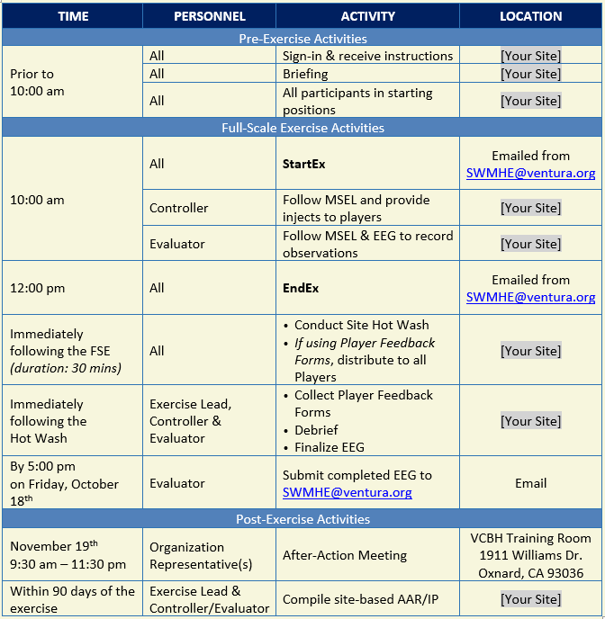
SCHEDULE

Slide 4
Exercise Overview
This exercise will provide a forum for Ventura County to support and interface with healthcare providers, emergency management, and response partners as part of a comprehensive exercise.
Planning and response activities will take place in coordination with the overarching SWMHE program, which is led by the California Department of Public Health (CDPH) and the Emergency Medical Services Authority (EMSA).
This exercise has been developed with funding from Public Health Emergency Preparedness (PHEP) and Hospital Preparedness Program (HPP) grants.

Slide 5
Exercise Purpose
To evaluate player actions against current response plans and capabilities for an earthquake response.
Today’s exercise is a community-based, Full-Scale Exercise which will help us and our community to be better prepared for emergencies and incidents.
This exercise will utilize all-hazards, multi-discipline objectives aligned with Homeland Security Exercise and Evaluation Program (HSEEP), PHEP, and Health Care Preparedness and Response capabilities, guidelines, and requirements.

Slide 6
Exercise Scope
This exercise is being conducted to evaluate existing plans, policies, and procedures in a no-fault environment.
The pre-written MSEL will manage the flow of the exercise by providing injects via Controllers.
Players will respond to defined injects.
Exercise play will include “boots on the ground” components and discussion by exercise participants.
This exercise has been designed by Emergency Preparedness Office personnel, Ventura County Health Care Coalition personnel, and Stakeholder Liaisons from several participating sites.

Slide 7
External Objectives
Immediately after shaking has subsided, players will assess safety of individuals and the integrity of the building in accordance with the site’s emergency plan and submit a Situation Status Report (SitRep) to the Ventura County Health Care Coalition.
During exercise play, players will follow the Policies and Procedures for loss of power in accordance with the site’s emergency plan.
Within the first 30 minutes of the exercise, players will assess their current supply levels and determine the length of time operations can be sustained.
Within 1 hour of StartEx, players will engage business continuity plans to assess financial impact and the ability to maintain critical operations.

Slide 8
Exercise Assumptions & Artificialities
In any exercise, assumptions and artificialities may be necessary to complete play in the time allotted and/or account for logistical limitations.
Exercise participants should accept that assumptions and artificialities are inherent in any exercise, and should not allow these considerations to negatively impact their participation.
1 of 3

Slide 9
Exercise Assumptions & Artificialities
The FSE is conducted in a no-fault learning environment wherein capabilities, plans, systems, and processes – not individuals – will be evaluated.
The FSE scenario is plausible, and events occur as they are presented.
FSE simulation contains sufficient detail to allow players to react to information and situations as they are presented as if the simulated incident were real.
Participating agencies may need to balance FSE play with real-world emergencies. Real world emergencies take priority.
Decisions are not precedent setting and may not reflect your organization’s final position.
Time lapses may be inserted to achieve the FSE objectives.
2 of 3

Slide 10
Exercise Assumptions & Artificialities
Impacts are seen across the spectrum of the response community.
Participants should use existing plans, policies, and procedures. If during the course of the FSE there is disagreement with existing plans, policies, and procedures, this should be noted, and relevant stakeholders should assess the need to change documents after the FSE.
There are no “hidden agendas” or trick questions.
All players receive information at the same time.
If a player would normally contact an individual or department that is not represented at the FSE, they should tell the Evaluator what information they need and who they would contact. This action should be noted.
3 of 3

Slide 11
Simulations
The FSE is of limited duration and scope; certain details will be simulated.
Example: Building Safety Evaluation

Slide 12
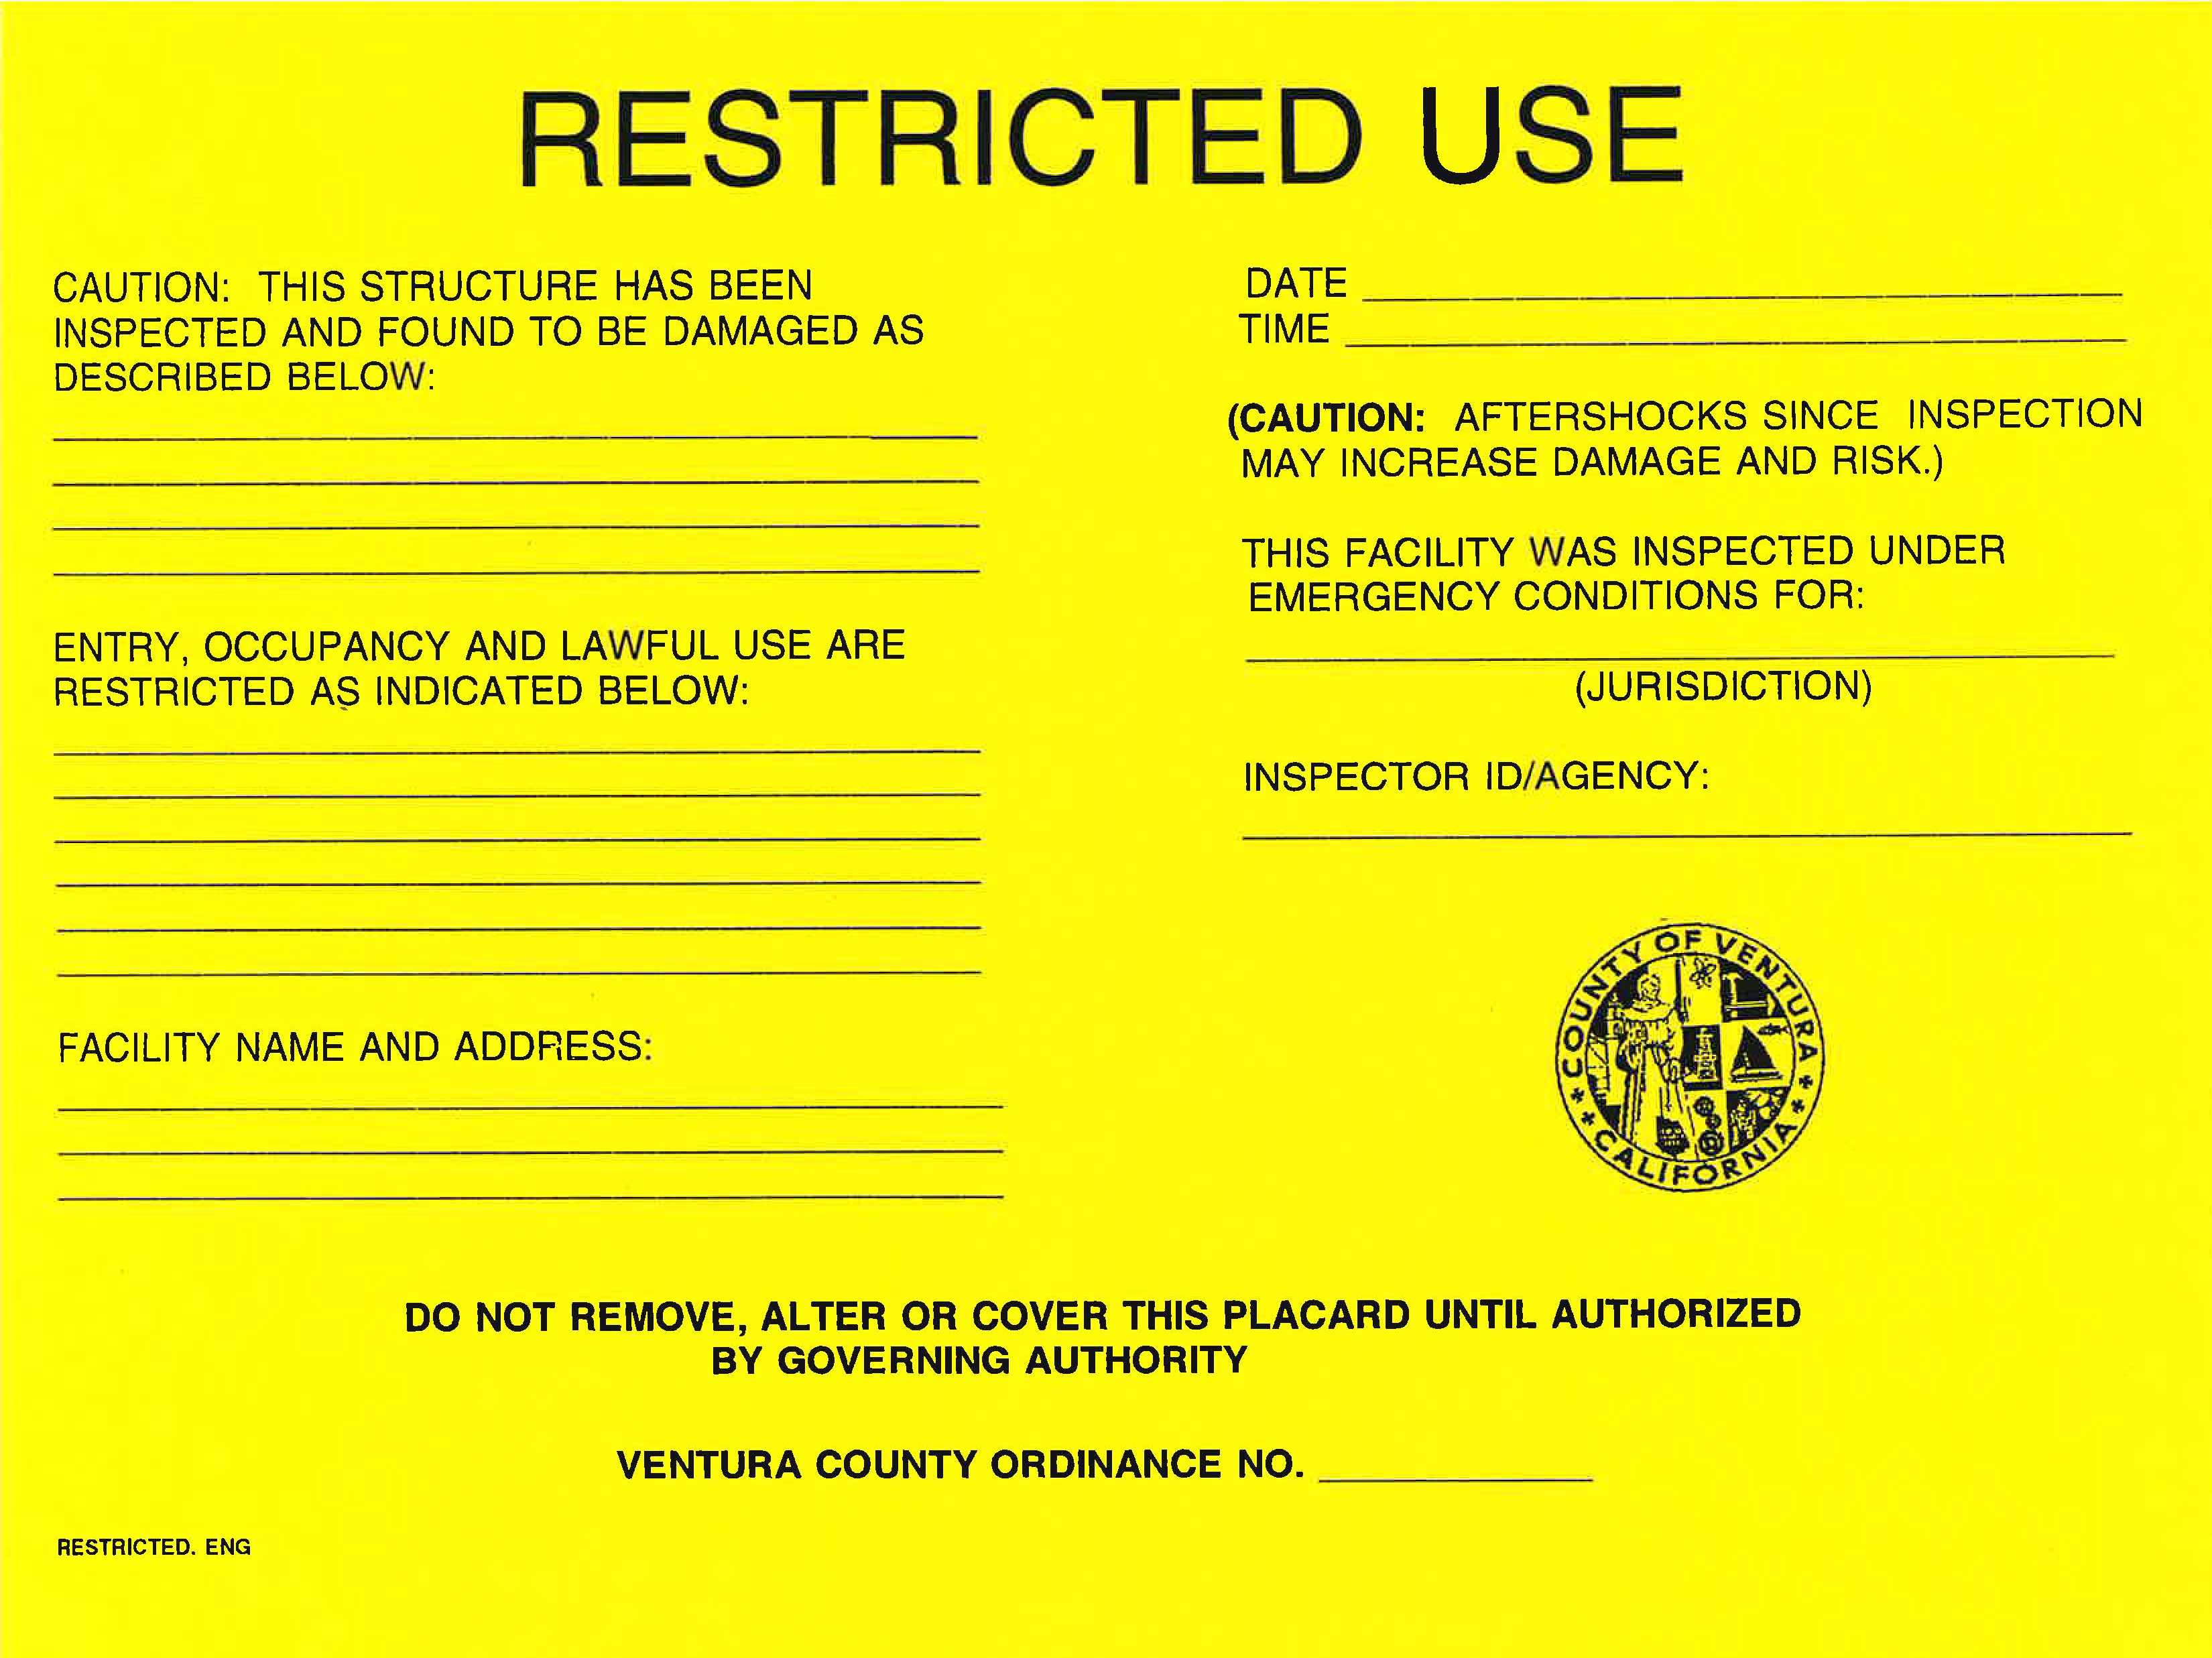
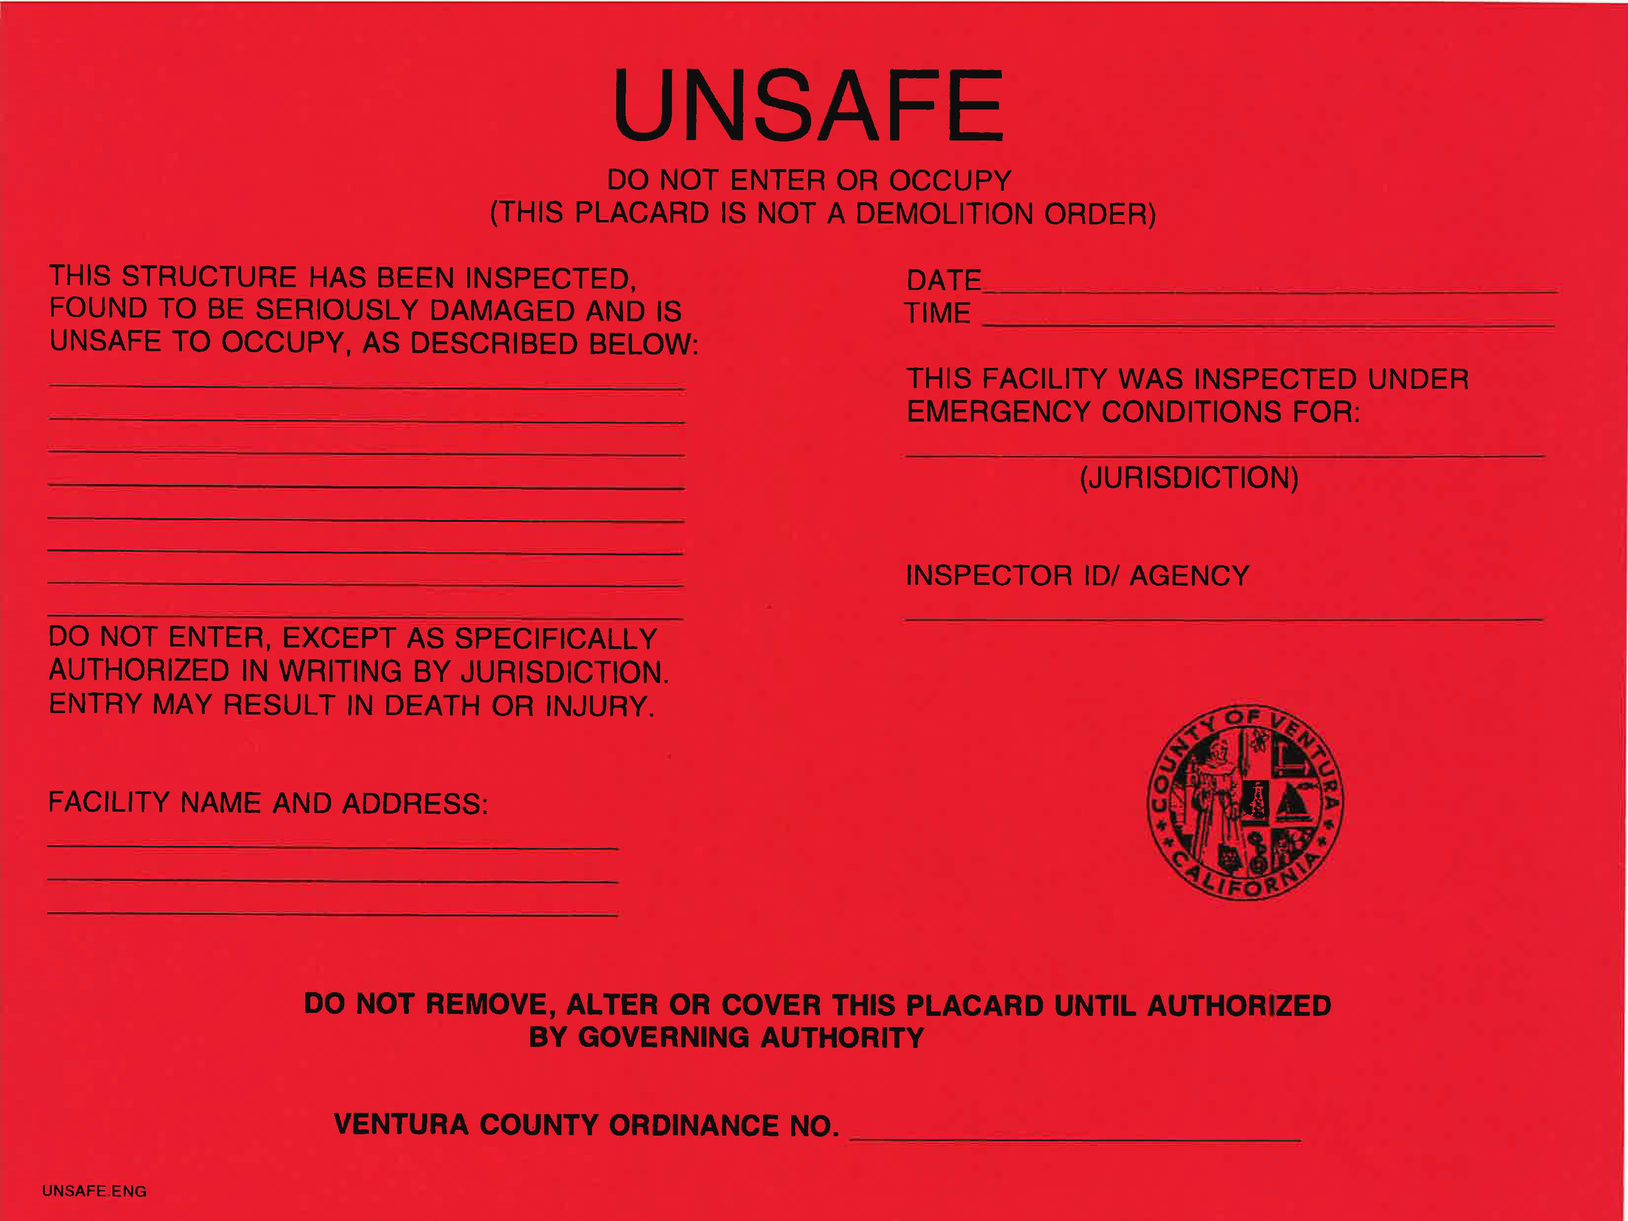
Building Safety Evaluation
No visible damage considerations may include future reports of unsafe conditions, repairs, or reinspection/further analysis.
Partial damage considerations may include restricted use such as: no access to specific areas, brief entry to areas, etc.
Significant damage considerations may include cascading events such as: partial collapse or damage to the building, utility failure, pollution/contamination (e.g. air quality or water), fire, explosion, chemical spill, etc.

Slide 13
Player Instructions
Respond to FSE events and information as if the emergency were real, unless otherwise directed by an FSE Controller.
Speak when you take an action. This procedure will ensure that the Evaluator is aware of critical actions as they occur.
All FSE communications will begin and end with the statement “This is an exercise.” This precaution is taken so that anyone who overhears the conversation will not mistake FSE play for a real-world emergency.
Controllers will only give you information they are specifically directed to disseminate. You are expected to obtain other necessary information through existing emergency information channels.
Do not engage in personal conversations with Controllers, Evaluators, Observers, or Media Personnel.
Parts of the scenario may seem implausible. Every effort has been made to balance realism with safety, and to create an effective learning and evaluation environment.
Maintain a log of your activities. Many times, this log may include documentation of activities that were missed by a Controller or Evaluator.
The ICS 214 form may be used by players to log activities if the site is compliant with ICS.

Slide 14
Player Instructions – After Exercise Play
Attend Hot Wash
If applicable, Complete a Player Feedback Form
Submit to Evaluator
Provide any notes/materials generated from the FSE to your Controller or Evaluator for review and inclusion in the After-Action Report.
Assist with cleanup operations to restore the area to pre-FSE conditions

Slide 15
Introductions: Exercise Staff Positions
Exercise Lead
Safety Officer
Controller
Evaluator
Players
If participating: Observers, Media, Victim Volunteers
Should be escorted at all times
Should not interfere with exercise play nor talk to players
Notes:
Introduce/identify all participating personnel who are assuming roles.

Slide 16
Safety
Safety is everyone’s concern; any safety concerns must be immediately reported to the Safety Officer.
FSE participant safety takes priority over FSE events.
All participants should notify Safety Officer and the Controller if they observe another participant who is seriously ill or injured.
All participants should advise the Safety Officer or Controller of any unauthorized persons.
Safety concerns override exercise execution
The Safety Officer and Exercise Lead will determine if a real-world emergency warrants a pause in FSE play and when FSE play can be resumed.
Actual emergencies will be identified by the saying: “THIS IS NOT AN EXERCISE.”
A controller aware of a real emergency will initiate the “THIS IS NOT AN EXERCISE” broadcast and provide the Exercise Lead with the location of the emergency and resources needed, if any.
Notes:
This should be read by the Safety Officer

Slide 17
Safety – Site Control
All participants must check in before the FSE begins.
Media/Observers are escorted to designated areas and accompanied by the PIO at all times.
Exercise in Progress signs should be posted.
All existing fire hydrants on the site are accessible.
Notes:
This should be read by the Safety Officer

Slide 18
Controller
Manages FSE play by
Directing the pace of the exercise
Providing key data to players (injects & inject supplementals, such as email messages and building assessment/evaluation)
Prompting/initiating certain player actions in accordance with instructions provided in the Master Scenario of Events List (MSEL)
Notes:
This should be read by the Controller

Slide 19
Evaluator
Observes and documents performance against established objectives and expected outcomes/actions, in accordance with the Exercise Evaluation Guide (EEG).
Notes:
This should be read by the Evaluator

Slide 20
Exercise Identification
GROUP | BADGE / VEST
[Exercise Lead]
[Safety Officer]
[Controllers]
[Evaluators]
[Actors/Victim Volunteers]
[Support Staff]
[Observers]
[Media Personnel]
[Players, Uniformed]
[Players, Civilian Clothes]
[Players, PIO]
Notes:
If you are utilizing a form of identification (i.e. badge, vest, hat) complete the table on this slide.
If you are NOT utilizing any form of identification, DELETE this slide.

Slide 21
Scenario
Scenario should not be read aloud, in full, now.

Slide 22
Questions?

Slide 23
Thank you!

